Slide 1
Year 4
Place Value
To understand how to partition numbers to 1,000

Slide 2
Summary
Key Vocabulary and Sentence Stems
Diagnostic Question
Learning Objective
Starter – Identifying 2-digit numbers
Let’s Learn
Follow Me – Showing a number in different ways
Your Turn (1) – Showing a number in different ways
Follow Me – Make the number using Base 10
Your Turn (2) – Make the number using Base 10
Follow Me – Expanded form
Your Turn (3) – Expanded form
Let’s Reflect
Support Slides – Based on making numbers using Base 10

Slide 3
Key Vocabulary
partition | partitioning
Sentence Stems
There are (digit) hundred(s), (digit) ten(s) and (digit) one(s). The number is (total).
There are 2 thousands, 5 hundreds, 3 tens and 9 ones. The number is 2,539.

Slide 4
There are 7 hundreds, 4 tens and 9 ones.
The number is ______.
700409
7409
749
20
Notes:
Assessment point for the lesson – ask the pupils to vote for the answer they think is correct.
A – The pupil doesn’t understand zero as a place holder.
B –The pupil has included a placeholder where it’s not needed.
C – Correct answer.
D – The pupil has added 7, 4 and 9.

Slide 5
To partition numbers to 1,000

Slide 6
Starter
Which numbers are represented?
53
49
Answers
Notes:
Concrete resources – Counters, base 10
Key Questions – Which numbers are represented? How do you know? Can you use other resources to create these numbers? How many tens are there? How many ones? Do you need to count all the cubes in the orange stick?

Slide 7
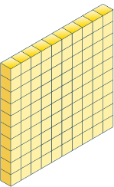
Let’s Learn
What number does the Base 10 represent?
321
Answers
Notes:
Concrete resources – Base 10
Key Questions – What number is represented? How do you know? How would I write the number in digits? How would I write it in words? What do you notice? If there were 0 tens, how would I represent write the number?
Misconceptions/ Common Errors – Pupils not understanding what the hundreds square of the Base 10 means.

Slide 8
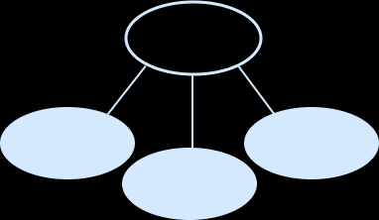
Follow Me
Represent the number in different ways.
217
Base 10 | Sentence Stem | Part-whole model
 | There are _____ hundreds, _____ tens and _____ ones. The number is _____.
2
217
1
7
200
7
217
10
Answers
Notes:
Concrete resources – Base 10
Key Questions – How do we show 217 in different ways? What do all these representations have in common? What do you notice? What is different?
Misconceptions/ Common Errors – Pupils may partition 217 into digits in the part-whole model.

Slide 9
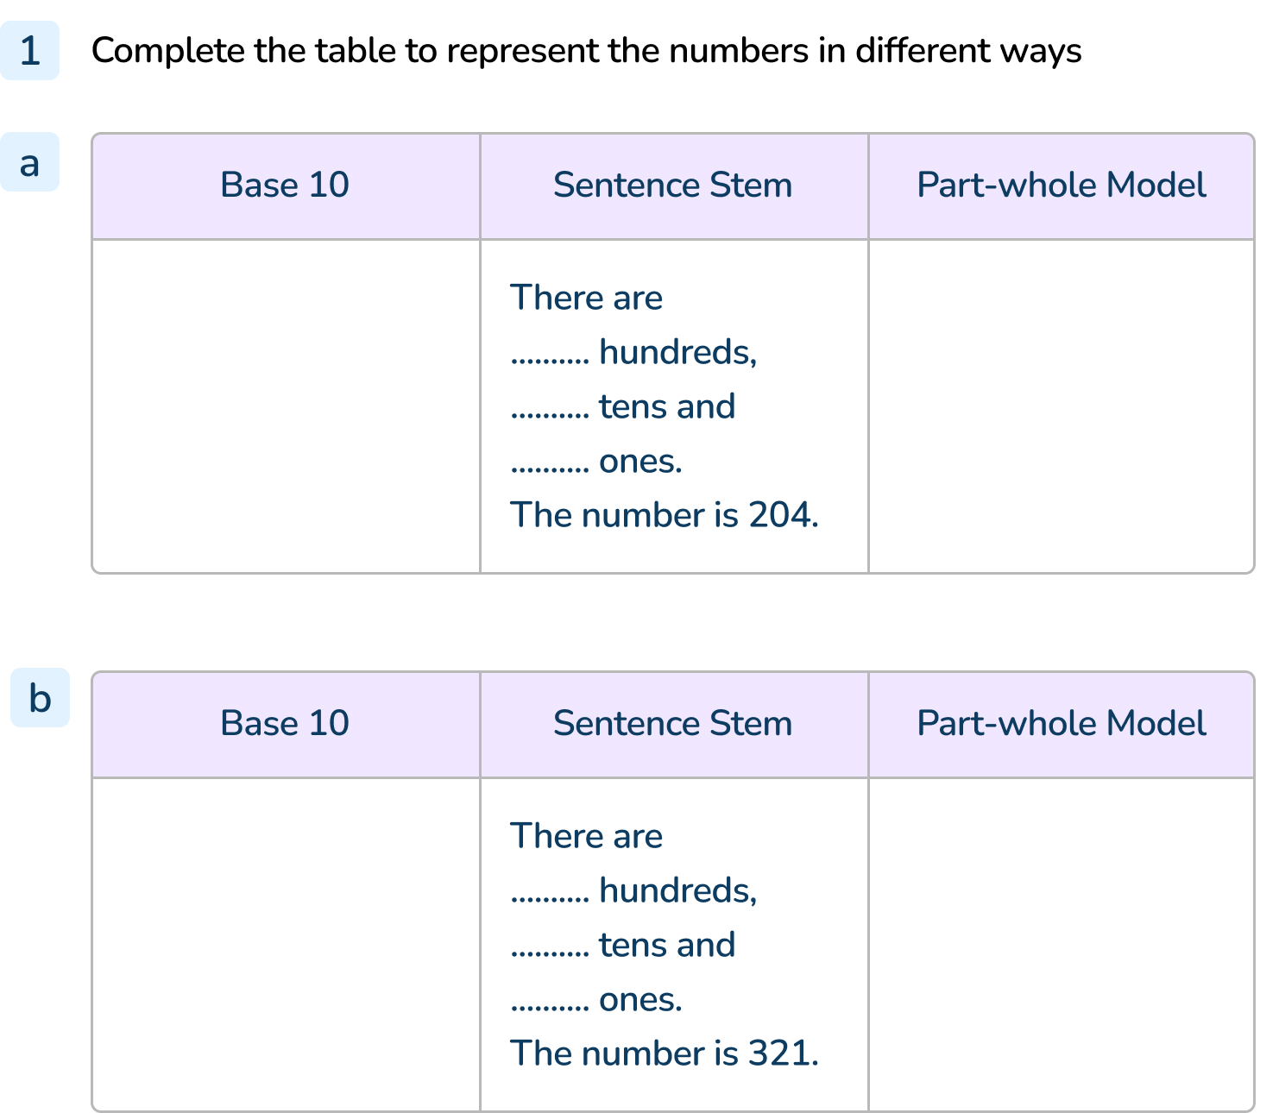
Your Turn
Notes:
Pupils should have completed the Base 10 using appropriate equipment.
a) There are 2 hundreds, 0 tens and 4 ones. The number is 204. The part-whole model should show a whole of 204 and parts of 200 and 4.
b) There are 3 hundreds, 2 tens and 1 one. The number is 321. The part-whole model should show a whole of 321 and parts of 300, 20 and 1.

Slide 10
Follow Me
Using Base 10, how would you represent these numbers?
327
208
211
Answers
Notes:
Concrete resources – Base 10
Key Questions – How many hundreds/ tens/ ones are in the number? How do you represent 100 using Base 10? How many tens make 1 hundred? How many ones make 1 ten?
Extension – Can you represent these numbers using a different resource or using a pictorial representation?

Slide 11
Your Turn
Notes:
Pupils should accurately make the numbers using the base 10.

Slide 12
Follow Me
Write the numbers in their expanded form.
452 = _____ + _____ + _____
334 = _____ + _____ + _____
217 = _____ + _____ + _____
400 + 50 + 2
300 + 30 + 4
200 + 10 + 7
Answers
Notes:
Concrete resources – Base 10
Key Questions – How many hundreds are there? How many tens are there? How many ones are there? Do we write the numbers or digits when writing number sentences? Why do we not write digits? How are 400 and 4 different?
Misconceptions/ Common Errors – Pupils may write 4 + 5 + 2 for example
Extension – Write another number sentence but make a mistake. Can pupils identify the mistake? Pupils can work in partners to write a number sentence with a mistake and correct it.

Slide 13
Your Turn
Notes:
10 is incorrect, it should be 0
50 is incorrect, it should be 500
300 and 800 are incorrect, they should be 30 and 8
7 and 3 are incorrect, they should be 700 and 30
8 is incorrect, it should be 80

Slide 14
Let’s Reflect
Here is a partitioned number.
What is the whole number?
3 + 10 + 500
The whole is 513.
Answers
Notes:
Concrete resources – Base 10
Key Questions – What do you notice about the number sentence? Why might this be confusing? Why is it important to understand the place value of number?
Misconceptions/ Common Errors – Pupils may write 315 as they are used to seeing the a number partitioned in size order.
Extension – Tell pupils to give the wrong answer and explain why it is wrong.

Slide 15
The following slides are based on: Making numbers using Base 10

Slide 16
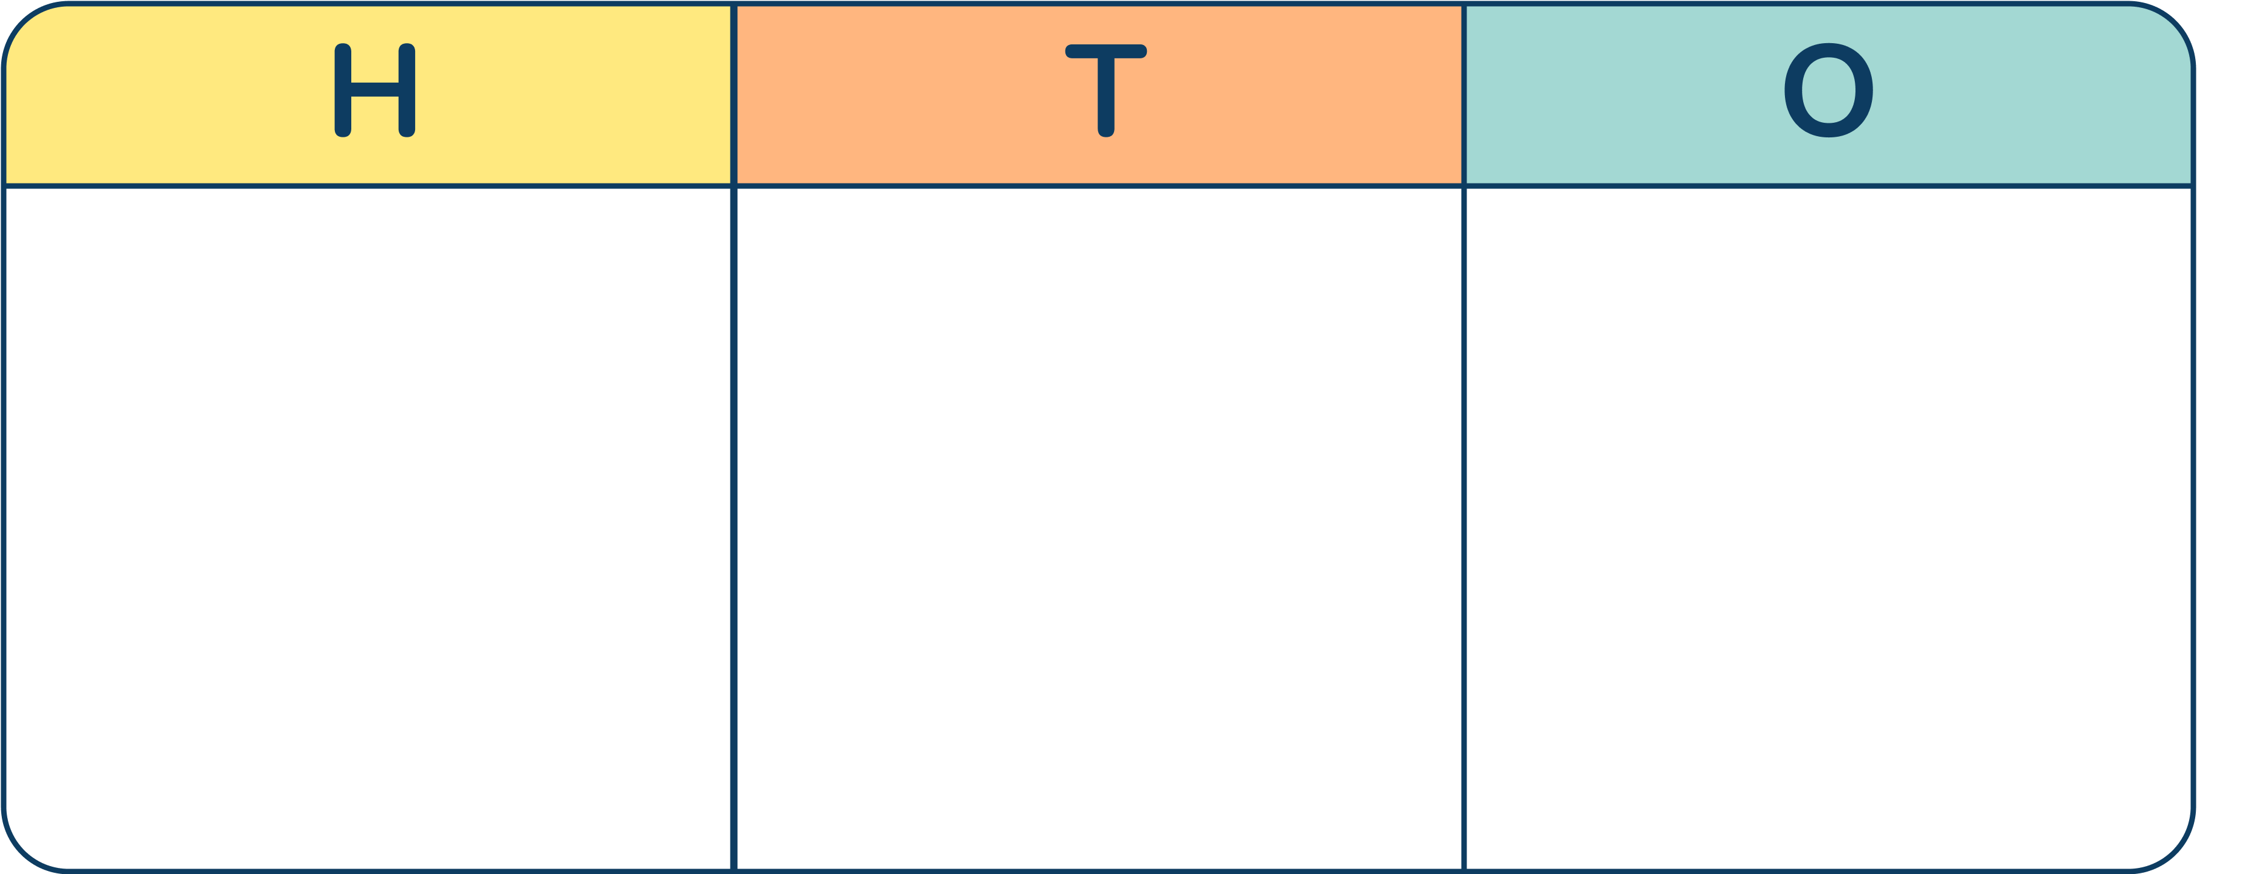
What number is represented in each place value chart?
162
234
Answers
Notes:
How and when to use these slides – Use these slides if pupils are struggling to partition numbers and need to recap the value of Base 10 and how this relates to a number written in digits.
Concrete resources – Base 10
Key Questions – How many hundreds blocks have you used? How many tens blocks have you use? How many ones blocks? What number does this make? How many tens make 100? How many ones make 10?
Misconceptions/ Common Errors – Pupils may try to count each square individually.

Slide 17
Use Base 10 to make a number.
Write the numbers you make down.
Notes:
Concrete resources – Base 10
Key Questions – Which numbers did you make? How many of each Base 10 pieces did you use? How many hundreds/ tens/ ones pieces did you use? If you didn’t use any ones/ tens, how did you write the number? What is a placeholder?
Misconceptions/ Common Errors – Pupils not understanding how changing position of counters changes the number.

