Slide 1
Year 1
Place Value (within 10)
To know how to compare numbers

Slide 2
Summary
Key Vocabulary and Sentence Stems
Diagnostic Question
Learning Objective
Starter – Representing numbers
Let’s Learn – The inequality symbols
Follow Me – Comparing numbers (words)
Your Turn (1) – Comparing numbers (words)
Follow Me – Comparing numbers (symbols)
Your Turn (2) – Comparing numbers (symbols)
Follow Me – Comparative statements
Your Turn (3) – Comparative statements
Let’s Reflect
Support Slides – Based on comparing non-identical objects

Slide 3
Key Vocabulary
greater than | less than
equal to
Sentence Stems
(number) is greater than (number). Also ‘more than’ can be used.
7 is greater than 5.
(number) is smaller than (number). Also ‘less than’ can be used.
5 is smaller than 7.

Slide 4
Which symbol would you use to compare these numbers?
5
8
>
=
<
None of these
Notes:
Assessment point for the lesson – ask the pupils to vote for the answer they think is correct.
A – The pupil does not understand what the symbol means.
B – The pupil does not understand what the symbol means.
C – Correct answer
D – The pupil might not understand what any of the symbols mean and as such has not selected any of the answers.

Slide 5
To compare numbers

Slide 6
Starter
The Mathlings have said a number each.
Use concrete resources to show these numbers.
8
5
Notes:
Concrete resources – A range of concrete resources (e.g. counters, number shapes etc)
Key Questions – How many ways can you show 8? How many ways can you show 5? Would you rather have 5 cupcakes or 8 cupcakes? Why?
Extension – What is 1 more/ less than each number?

Slide 7
Let’s Learn
Can you remember what these symbols mean?
When do we use these symbols?
Using cubes - Can you show me how you use them?
This means less than.
2 is less than 5.
This means greater than.
5 is more than 2.
This means equal to.
5 is equal to 5.
Notes:
Concrete resources – Counters or cubes and strips of paper etc to recreate the symbols (you may want to physically make the symbols in the classroom to show that the smaller amount of cubes go at the smaller end of the symbol)
Key Questions – What do you notice about the symbols? Can you show me less than, greater than and equal to using cubes?
Misconceptions/ Common Errors – Pupils not understanding how the symbols relate to the words.

Slide 8
Follow Me
Use resources to make these numbers.
Which is greater?
Use number tracks to check your answer.
4
6
1 | 2 | 3 | 4 | 5 | 6 | 7 | 8 | 9 | 10
6 is greater than 4.
Answers
Notes:
Concrete resources – Cubes or other appropriate concrete resources (e.g. counters), number tracks
Key Questions – Which number is greater? How can we prove this?
Misconceptions/ Common Errors – Not understanding the language used.

Slide 9
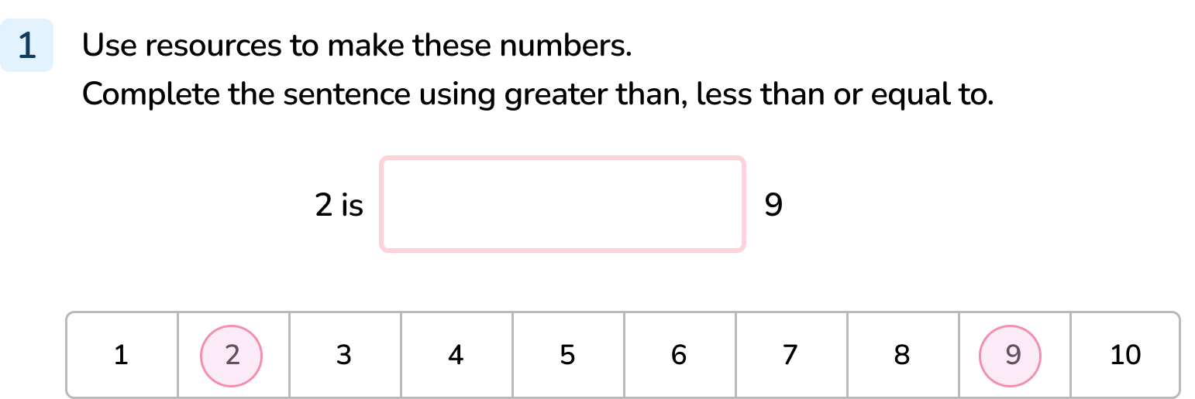
Your Turn
Notes:
2 is less than 9.

Slide 10
Follow Me
Use < , > or = to make these sentences correct.
6
7
<
8
3
>
4
4
=
Answers
Notes:
Concrete resources – Cubes, counters, number shapes etc to create the given numbers.
Key Questions – Which number is greater in each pair? Which symbol would you use to show this? Can you read the number sentence (e.g. six is less than seven)?
Misconceptions/ Common Errors – Pupils not understanding the given symbols.

Slide 11
Your Turn
Notes:
>
=
>

Slide 12
Follow Me
Choose your own numbers to complete the statements.
<
>
=
Notes:
Answers will vary.
Concrete resources – Number cards, cubes etc
Key Questions – Which number will you put first? What does each symbol mean? What do you notice? How are your answers similar or different to someone else's?
Misconceptions/ Common Errors – Inconsistencies when remembering inequality symbols.
Further Practice – Comparing using cubes or number tiles

Slide 13
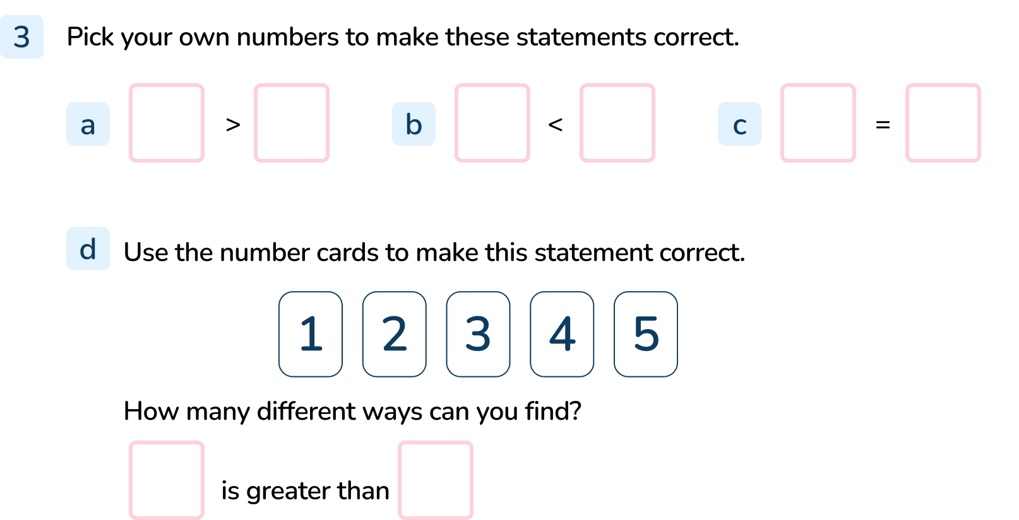
Your Turn
Notes:
a – c) Answers will vary depending on the choice of numbers.
d) 5 is greater than 4/3/2/1.
4 is greater than 3/2/1.
3 is greater than 2/1.
2 is greater than 1.

Slide 14
Let’s Reflect
One of these statements is incorrect.
Use cubes to prove which one.
8 > 3
6 > 9
6 > 10
Answers
Notes:
Concrete resources – Counters, cubes, number shapes etc to represent the statements.
Key Questions – What does the symbol mean? How do you know? Which of these statements is correct? Can you prove it?
Misconceptions/ Common Errors – Pupils may not remember what the symbols mean.

Slide 15
The following slides are based on: Compare non-identical objects

Slide 16
Which group has more?
Notes:
How and when to use these slides – Use this slide if pupils need to recap comparing objects before comparing numbers. These slides use non-identical objects for comparison.
Concrete resources – Two sets of non-identical objects.
Key Questions – How many fish are there? How many cars are there? Which group has more? How do you know?
Misconceptions/ Common Errors – Pupils thinking that they both have the same amount.

Slide 17
Which group has more?
Notes:
Concrete resources – Two different sets of items.
Key Questions – How many balls are there? How many trains are there? What do you notice? Does one group have more?
Misconceptions/ Common Errors – Pupils may think that the top row always has more. Pupils may not understand how to compare equal groups.

