Slide 1
Year 1
Place Value (within 10)
To know how to compare numbers of objects (2)

Slide 2
Summary
Key Vocabulary and Sentence Stems
Diagnostic Question
Learning Objective
Starter – Recapping learning through open ended question
Let’s Learn
Follow Me – Identifying which group has more
Your Turn (1) – Identifying which group has less
Follow Me – Completing a comparative sentence
Your Turn (2) – Completing a comparative sentence
Follow Me – Introducing and making the <, >, = symbols (inequality)
Your Turn (3) – Comparing objects using inequality symbols
Let’s Reflect
Support Slides – Based on comparing quantities of identical objects

Slide 3
Key Vocabulary
more | most
less | least
equal | greater than
fewer than
Sentence Stems
(number) is greater than (number). Also ‘more than’ can be used.
7 is greater than 5.
(number) is smaller than (number). Also ‘less than’ can be used.
5 is smaller than 7.

Slide 4
How would you describe the amount of fruit?
There are more apples.
There are more bananas.
There are fewer apples than bananas.
There are equal numbers of apples and bananas.
Notes:
Assessment point for the lesson – ask the pupils to vote for the answer they think is correct.
A – Correct answer.
B – The pupil may have looked at how spread out the bananas are, not counted the total.
C – The pupil may not understand the language of ‘fewer’.
D – The pupil may not understand the language of ‘equal’.

Slide 5
To compare numbers of objects

Slide 6
Starter
The Mathling is growing flowers.
What can you say about the flowers?
Notes:
This is a deliberately open question. Encourage pupils to count the number of flowers in each group and the number of flowers altogether. They may use comparative language (from yesterday).
Concrete resources – Real flowers or concrete resources to represent flowers
Key Questions – What can you tell me about the flowers? What do you notice? How many yellow flowers are there? How many orange? How many flowers altogether?
Misconceptions/ Common Errors – Understanding of comparative language - equal to. Pupils struggling as they don’t know how to answer an open ended question.

Slide 7
Let’s Learn
Use the words ‘greater than’ and less than’ to describe the group of dogs and cats.
The number of dogs is greater than the number of cats. The number of cats is less than the number of dogs.
Answers
Notes:
Concrete resources – Counters in two colours to represent the groups
Key Questions – Which group has more? How can you tell which group as the least/ most? Which total is greater than the other total? What do you notice? How can you use counters to show that 5 is greater than 2?
Misconceptions/ Common Errors – Adding all the groups together or miscounting the totals.

Slide 8
Follow Me
Are there more rabbits or snails?
Complete the stem sentence.
snails
rabbits
The number of ________________ is greater than the number of _________
There are more snails.
Answers
Notes:
Concrete resources – Counters in two colours to represent the rabbits and snails
Key Questions – How many rabbits are there? How many snails are there? Are there more or less snails? Which words would fit in the sentence?
Misconceptions/ Common Errors – Pupils confusing size and amounts.

Slide 9
Your Turn
Notes:
The sharpeners have less than the rubbers.

Slide 10
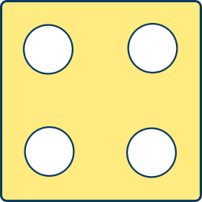
Follow Me
Use greater than, less than or equal to, to complete the sentences.
less than
is ____________________
greater than
is ____________________
equal to
is ____________________
Answers
Notes:
Concrete resources – Representations on the screen
Key Questions – How many are in each group? Which group is larger/ smaller? Which words can we use to compare the groups?
Misconceptions/ Common Errors – Misunderstanding vocabulary given
Extension – Pupils to be given stem sentences and use objects to complete

Slide 11
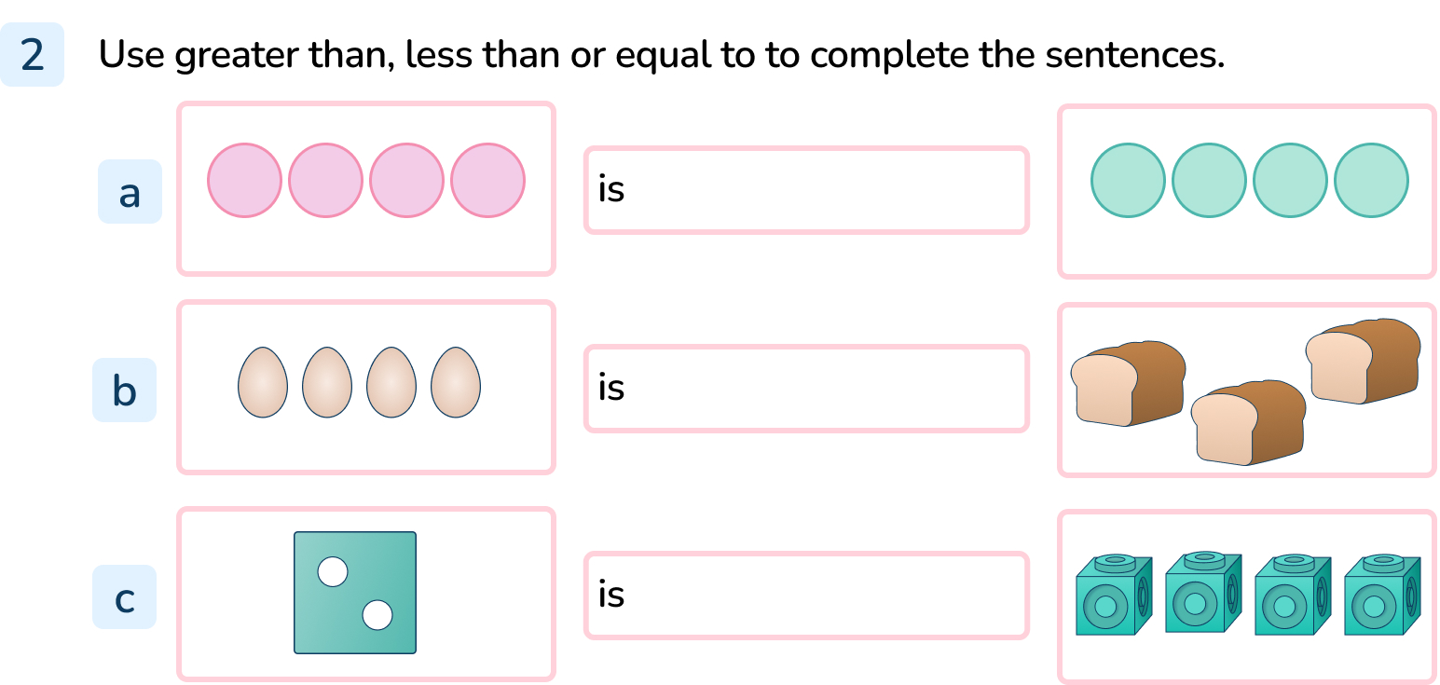
Your Turn
Notes:
equal to
greater than
less than

Slide 12
Follow Me
Using straws/ strips of paper and cubes make the less than, greater than and equal to symbols.
This means less than.
2 cubes is less than 5 cubes.
This means greater than.
5 cubes is greater than 2 cubes.
Test a partner to see if they can put the right symbol between different amount of cubes. E.g.
<
This means equal to.
5 cubes is equal to 5 cubes
Notes:
Concrete resources – straws/strips of paper, cubes
Key Questions – What does equal mean? How do you show equal groups? How can you remember which is the greater than symbol? Which is the less than symbol?
Misconceptions/ Common Errors – Pupils may use the word ‘bigger’ rather than ‘greater’- for consistency of language, encourage pupils to use ‘greater than’. Pupils may get symbols mixed up.
Further Practice – Using counters or other concrete resources make different amounts for your partner. Which symbol would they need to compare them?

Slide 13
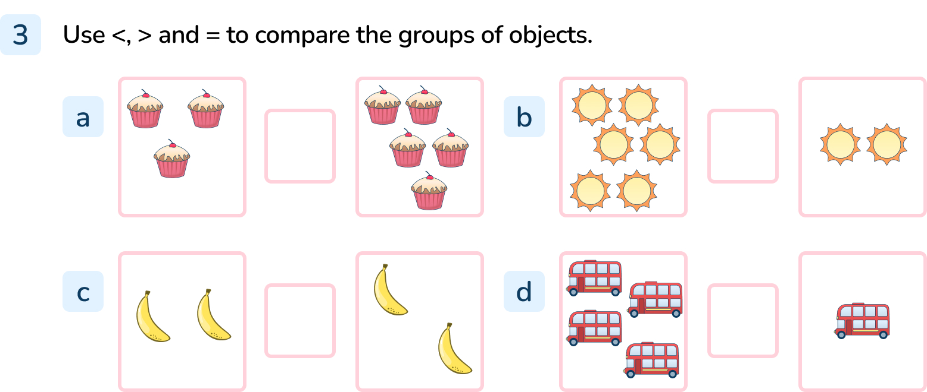
Your Turn
Notes:
<
>
=
>

Slide 14
Let’s Reflect
There are 6 cubes in one hand.
There are less than 6 cubes in the other hand.
How many could be in the other hand?
Explain how you know.
She could have 5, 4, 3, 2, 1 or 0 cubes.
Answers
Notes:
Concrete resources – Cubes
Key Questions – Would there be more or less in the other hand? How do you know? Could she have 0 cubes in the other hand?
Misconceptions/ Common Errors – Pupils not understanding the language of ‘less than’

Slide 15
The following slides are based on: Comparing quantities of identical objects

Slide 16
Which group has more than the other?
Answers
Notes:
How and when to use these slides – Use these slides if pupils are struggling to compare groups with different representations.
Concrete resources – 9 identical toys or concrete resources
Key Questions – How many ducks are in the first group? How many ducks are in the second group? Which group has more than the other?
Misconceptions/ Common Errors – Pupils saying they are the same because they use the same representations.

Slide 17
Which group has less than the other?
Answers
Notes:
Concrete resources – Counter (etc) to represent the balloons
Key Questions – How many balloons are in each group? Are you finding the group with more or less? Which one has less? How do you know?
Misconceptions/ Common Errors – Pupils not understanding the language.

