Slide 1
Year 1
Place Value (within 10)
To know how to count objects from a larger group

Slide 2
Summary
Key Vocabulary and Sentence Stems
Diagnostic Question
Learning Objective
Starter – Counting objects
Let’s Learn
Follow Me – Count from a group
Your Turn (1) – Circle amounts
Follow Me – Count from a group and show how many is left
Your Turn (2) – Colour amounts and show how many is left
Follow Me – Spot the mistake
Your Turn (3) – Classroom Hunt
Let’s Reflect
Support Slides – Based on counting objects

Slide 3
Key Vocabulary
numbers | counting
group
Sentence Stems
One, two (continue counting). There are (number) items.

Slide 4
A group of strawberries have been circled.
How many strawberries are left?
3
8
5
6
Notes:
Assessment point for the lesson – ask the pupils to vote for the answer they think is correct.
A – Pupils have counted the strawberries that have been circled
B – Pupils have counted all the strawberries.
C – Correct answer
D – Pupils have miscounted.

Slide 5
To count objects from a larger group

Slide 6
Starter
Here are some toy bears.
How many bears are there?
How many blue bears are there?
There are 8 bears.
There are 3 blue bears.
Answers
Notes:
Concrete resources – Manipulatives, cubes, counters etc
Key Questions – How many bears are there? If we move them around, are there still the same number? Count and check. Does it matter which object you count first? Should you start counting from 1 or zero?
Misconceptions/ Common Errors – Pupils may count the objects more than once or miss one out.
Further Practice – Different number of objects to count.
Extension – Use different number of cubes and test a partner.

Slide 7
Let’s Learn
In pairs - can you collect 10 cubes?
From your cubes:
Count out 6 cubes
Did you count all the cubes?
How many are left?
Test your partner - say a number and your partner has to count out that number of cubes.
Did they count them correctly?
Notes:
Answers will vary.
Concrete resources – Cubes
Key Questions – Does it matter which cube you count first? How do you know which you have counted and which you have not counted? Did you need to count them all? How many are left?
Misconceptions/ Common Errors – Pupils many count the cubes more than once or not counted correctly. Cubes may get mixed up with rest of cubes, encourage pupils to move the objects away as they count.
Further Practice – Different numbers to count out.
Extension – Use different colours to count out.

Slide 8
Follow Me
Count 4 buttons.
Compare your 4 buttons with your partners?
Are they the same or different?
Various answers
Answers
Notes:
Concrete resources – buttons, cubes, counters
Key Questions – How many objects are there? If I move them around, are there still the same amount? Count and check. Does the colour of the button matter? How do you know which objects you have counted and which you have not counted? Did you need to count them all? How many are left?
Misconceptions/ Common Errors – Children may count objects more than once or miss an object out that needs to be counted. The objects that have been counted may get mixed up
with the rest of the objects.
Further Practice – Count out different amounts from the group of buttons
Extension – Different starting amounts and different numbers to count. Test a partner.

Slide 9
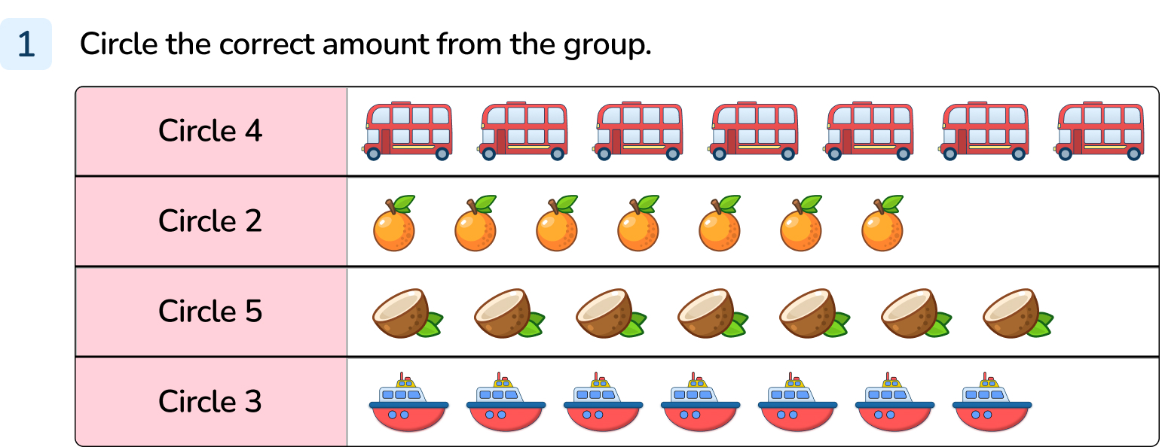
Your Turn
Notes:
4 circled
2 circled
5 circled
3 circled

Slide 10
Follow Me
Here are some toy cars.
Count out 5 cars.
Complete the sentences:
I need to count ______ cars from the group.
There are _______ cars left.
5
3
Answers
Notes:
Concrete resources – Toy cars, cubes, counters
Key Questions – How many have you counted? How do you know? Do you need to recount? Does it matter which object you count first? How do you know which objects you have counted and which you have not counted? Did you need to count them all? How many are left?
Misconceptions/ Common Errors – Pupils who have not grasped the cardinal counting principle will recount the whole group again.
Further Practice – different numbers of cars to count from the group
Extension – To test a partner on counting out the correct number.

Slide 11
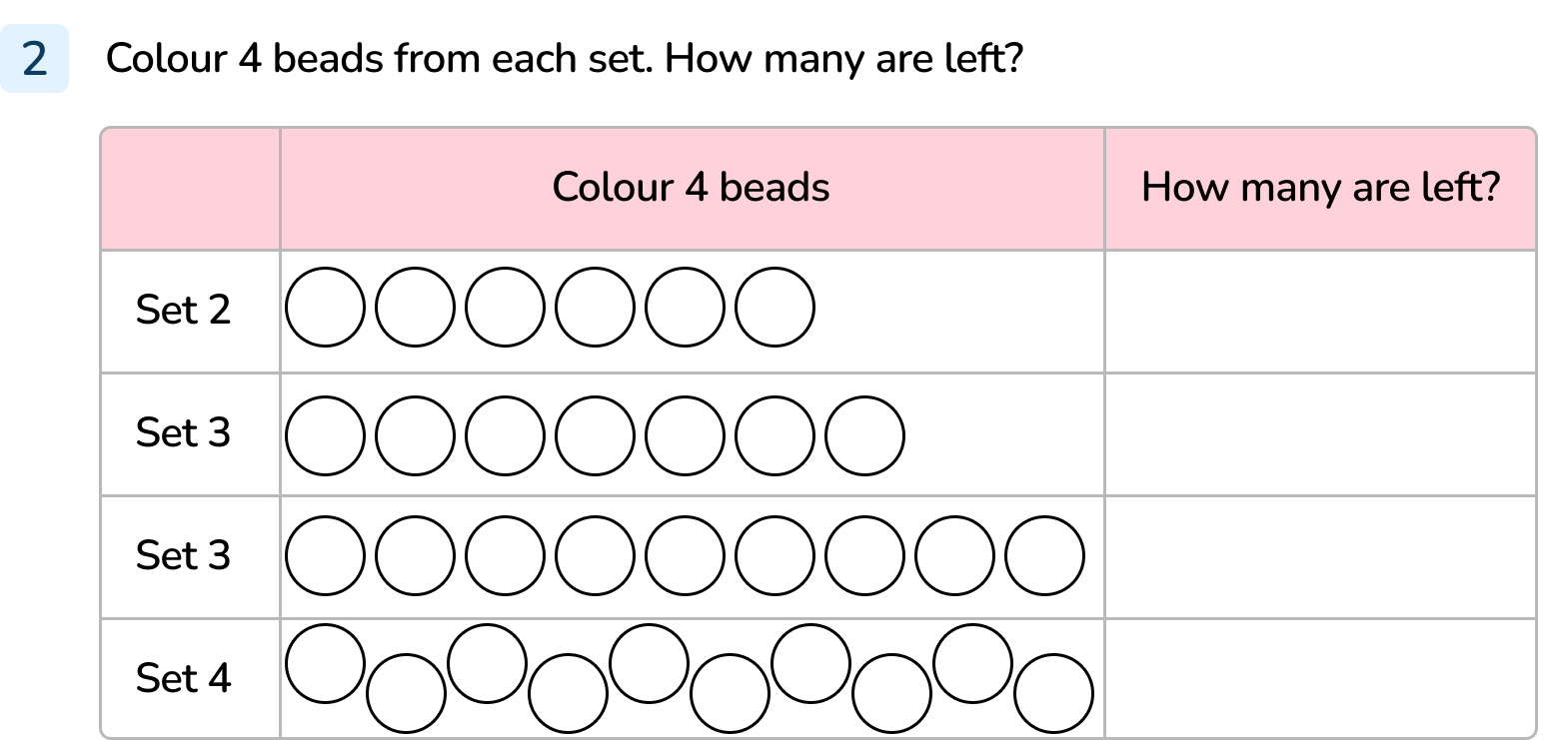
Your Turn
Notes:
Set 1: 2
Set 2: 3
Set 3: 5
Set 4: 6

Slide 12
Follow Me
The Mathling wants to count out 5 apples from the group.
Terra
No.
Terra is showing the amount not counted, rather than the amount counted.
Here is the answer. Is Terra correct?
Answers
Notes:
Concrete resources – manipulatives, cubes, counters
Key Questions – How many apples are there to start with? Can you count out 5? Does it matter which object you count first? How do you know which objects you have counted and which you have not counted? Did you need to count them all? How many are left? What mistake has Terra made?
Misconceptions/ Common Errors – Pupils who have not grasped the cardinal counting principle will recount the whole group again. Pupils may not see the mistake made.
Further Practice – Different amounts to count.
Extension – Different starting numbers. Can you work out what is left?

Slide 13
Your Turn
Notes:
Various answers depending on objects and numbers picked.

Slide 14
Let’s Reflect
Circle 3 basketballs.
How many basketballs are not circled in each set?
Circle 2 basketballs.
2, 3, 5
Circle 0 basketballs.
Answers
Notes:
Concrete resources – manipulatives, counters, cubes
Key Questions – How many basketballs are there? If I move them around, are there still the same amount? Count and check. Does it matter which basketball you count first? How do you know which objects you have counted and which you have not counted? Did you need to count them all? How many are left? Do you have to circle the basketballs that are next to each other? What does ‘zero’ mean?
Misconceptions/ Common Errors – Pupils who have not grasped the cardinal counting principle will recount the whole group again. Pupils may mix up the groups and not separate them when counting.
Further Practice – Different numbers to start with.
Extension – Use larger groups to count from. Can you work out what is left?

Slide 15
The following slides are based on:
Counting Objects

Slide 16
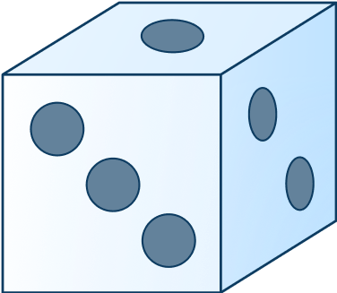
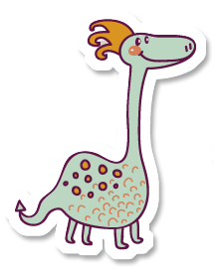
Gather a range of interesting objects to count.
Roll a dice and count out the corresponding amount.
Get a friend to check.
Notes:
How and when to use these slides – Some pupils may struggle when counting objects from a large group. If they do, use these slides to ensure they understand how to count from a group.
Concrete resources – variety of interesting objects, dice.
Key Questions – what number have you thrown? How do you know? Can you count out that number of objects and put them in front of you? Check your partner, have they counted correctly?
Misconceptions/ Common Errors – Pupils may mix up the groups and not separate them when counting. Encourage them to move the objects to a different place (or into a jar or on a plate) when counting. Pupils may miscount.
Further Practice – Different amounts to count.
Extension – Use number cards 1-10 instead of dice.

Slide 17
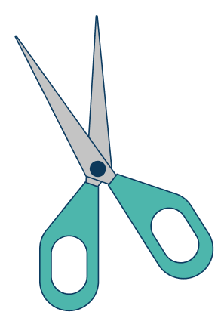
Count the objects and fill in the sentences below:
There are footballs. There are umbrellas.
There are pairs of scissors
6
3
4
Answers
Notes:
Concrete resources – manipulatives, cubes, counters
Key Questions – How many footballs are there? Can you touch them as you count? How many pairs of scissors? How do we write the number three?
Misconceptions/ Common Errors – Pupils may miscount the objects, they may need to move or cross out objects as they count.

