Slide 1
Year 1
Place Value (within 10)
To know how to use a number line

Slide 2
Summary
Key Vocabulary and Sentence Stems
Diagnostic Question
Learning Objective
Starter – Class counting
Let’s Learn
Follow Me – Identifying number on a number line
Your Turn (1) – Identifying number on a number line
Follow Me – Counting on on a number line
Your Turn (2) – Counting back on a number line
Follow Me – Identifying numbers on a blank number line (0 marked)
Your Turn (3) – Identifying numbers on a blank number line (0 marked)
Let’s Reflect
Support Slides – Based on counting to 10 in order

Slide 3
Key Vocabulary
1 more | 1 less
forwards/ count on | backwards
Sentence Stems
One, two (continue counting). There are (number) items.
Consecutive numbers have a difference of one.

Slide 4
Which number is missing?
0
1
2
3
4
5
7
8
9
10
6
5
7
0
Notes:
Assessment point for the lesson – ask the pupils to vote for the answer they think is correct.
A – Correct answer.
B – The pupil has identified the number before the missing number.
C – The pupil has identified the number after the missing number.
D – The pupil has identified the first number on the number line.

Slide 5
To use a number line

Slide 6
Starter
Start with 0 and count on to 10 as a class.
Challenge:
Count back from 10 to 0 as a class.
Notes:
Concrete resources – Counting stick
Key Questions – Which number comes next? How do you know? Can you count backwards? What is the same, what is different?

Slide 7
Let’s Learn
This is a number line.
We can use it to help us in maths.
What can you tell me about the number line?
0
1
2
3
4
5
6
7
8
9
10
Notes:
Use this slide to discuss what a number line shows us. Identify what we have used that is similar to a number line (number tracks)
Concrete resources – A number line
Key Questions – What can you see? What do you notice about the numbers? Are the lines evenly spaced or not? Where are the numbers written? Which number starts this number line? Which number ends this number line? (Avoid saying ’starts a number line’ as this may cause a misconception about number lines always starting with 0)

Slide 8
Follow Me
On the number line:
Circle the number 5
Underline a number greater than 6
Draw an arrow to the number 1 less than 4
Put a box round the greatest number
0
1
2
3
4
5
6
7
8
9
10
___
___
___
___
Answers
Notes:
Concrete resources – Number line
Key Questions – How are the numbers presented on the number line? What does each mark on the number line represent? Do we have to start counting from 0 each time?
Misconceptions/ Common Errors – Starting from 0 each time when identifying a number.
Further Practice – Find 1 less than or more than a given number.

Slide 9
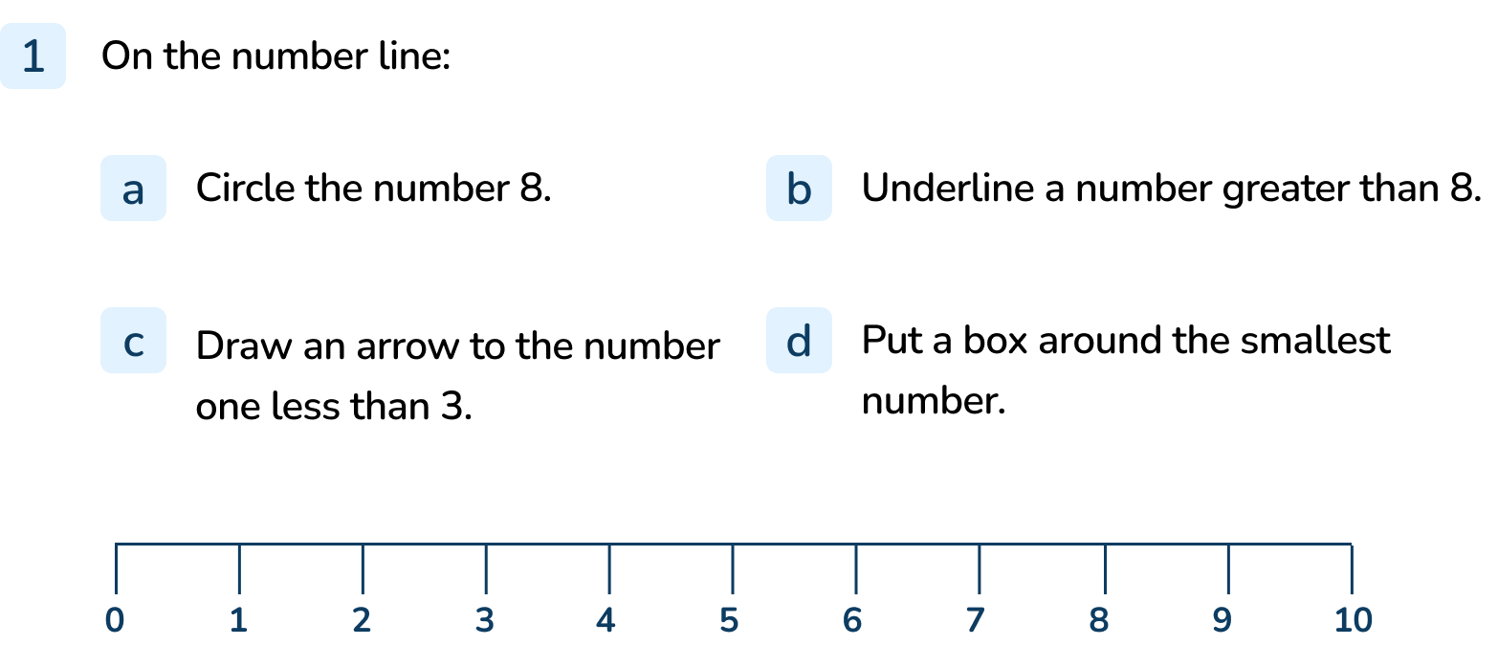
Your Turn
Notes:
Instructions should be accurately followed.

Slide 10
Follow Me
A frog starts on 0.
How many jumps does it need to take to get to 6?
It takes 6 jumps to get from 0 to 6.
0
1
2
3
4
5
6
7
8
9
10
He makes 1 more jump forward.
What number is he on now?
If he makes one more jump forward, he is on 7.
Answers
Notes:
Concrete resources – Number line
Key Questions – Where does the number line start? Which way will we jump when we find 1 more?
Misconceptions/ Common Errors – Counting the number rather than the jumps (e.g. counting 0 as 1)
Further Practice – Can you find 1 less?

Slide 11
Your Turn
Notes:
It takes 8 jumps to get from 0 to 8.
If he makes one more jump forward, he is on 9.

Slide 12
Follow Me
Write 4, 7 and 2 in the correct order on the number line.
0
2
4
7
Answers
Notes:
Concrete resources – Number line
Key Questions – How do we know where the numbers go? Why it is important to know the starting number on the number line?
Misconceptions/ Common Errors – Pupils thinking the number line starts on 1, not 0.

Slide 13
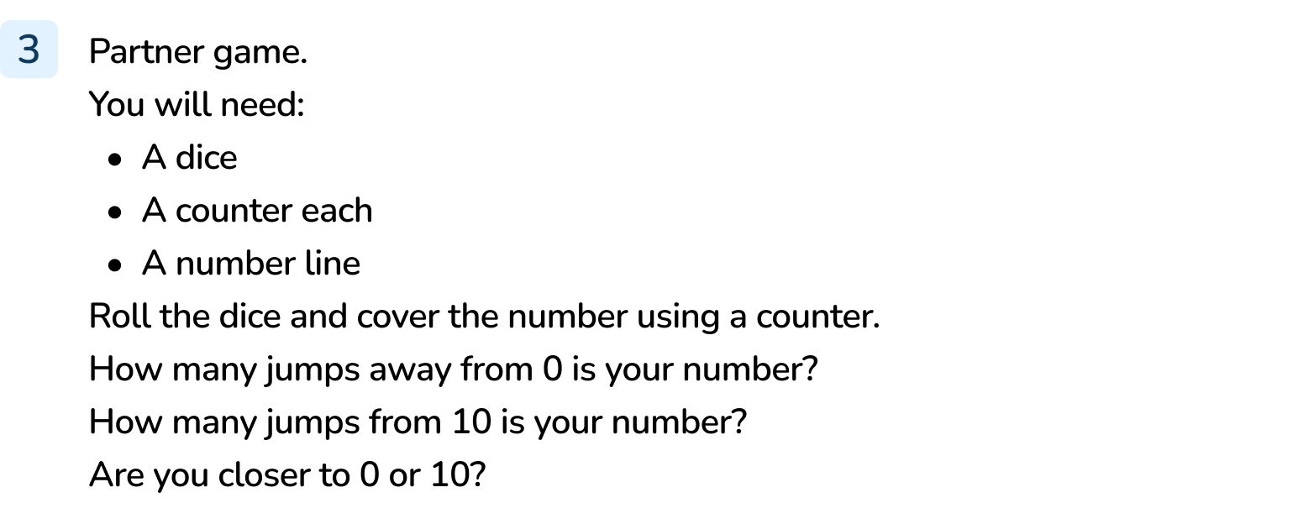
Your Turn
Notes:
Answers will vary as this is a game.

Slide 14
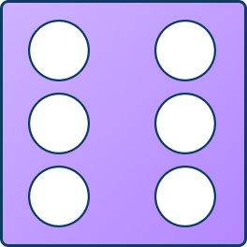
Let’s Reflect
The arrow is pointing to a number.
Which of these cannot represent the number the arrow is pointing to?
Talk about it with a partner.
0
1
2
3
4
5
6
7
8
9
10
Answers
Notes:
Concrete resources – Number line, number shapes, tens frames and counters, dice
Key Questions – Which number is the arrow pointing to? Which number are being represented? Which representation is the odd one out? What number does this represent? Where is that number on the number line?

Slide 15
The following slides are based on: Counting to 10 in order

Slide 16
What number is the arrow pointing to?
Notes:
How and when to use these slides – Pupils may not be ready to move on to number lines in an abstract form. Instead create number lines from mathematical representations (such as number shapes). Encourage the pupils to count on from one or identify a number they know and count on/ back from there.
Concrete resources – Number shapes
Key Questions – Which number am I pointing to? How do you know? Which number comes next?
Misconceptions/ Common Errors – Pupils may count on from one each time and not understand they can use their knowledge of numbers to count on/ back.

Slide 17
What number is the arrow pointing to?
Notes:
Concrete resources – Cubes
Key Questions – Which number am I pointing to? How do you know? Which number comes next?
Misconceptions/ Common Errors – Pupils may count on from one each time and not understand they can use their knowledge of numbers to count on/ back

