Slide 1
Year 3
Place Value
To understand how to represent 3-digit numbers using place value resources

Slide 2
Summary
Key Vocabulary and Sentence Stems
Diagnostic Question
Learning Objective
Starter – Represent numbers to 1,000 with base 10 equipment, with and without exchanges
Let’s Learn
Follow Me – Making number using counters in a place value chart
Your Turn (1) – Making number using counters in a place value chart
Follow Me – Complete a place value chart with counters for a given number
Your Turn (2) – Complete a place value chart with counters for a given number
Follow Me – Reasoning and problem solving
Your Turn (3) – Reasoning and problem solving
Let’s Reflect
Support Slides – Based on using a place value charts

Slide 3
Key Vocabulary
place value | hundreds
tens | ones
place holder
Sentence Stems
(number) is made up of (number) hundreds, (number) tens and (number) ones.
728 is made up of 7 hundreds, 2 tens and 8 ones.
(number) can be made using (number) hundred counters, (number) ten counters and (number) one counters.
728 can be made using 7 hundred counters, 2 ten counters and 8 one counters.
Zero is a place holder. It is used when a place has no value.

Slide 4
Which 3-digit number can be made by using all of these place value counters?
Give your answer in numerals and words.
543, five hundred and forty-three
354, three hundred and fifty-four
354, three hundred, fifty, four
300504, three hundred, fifty, four
Notes:
Assessment point for the lesson – ask the pupils to vote for the answer they think is correct.
A – The pupil has placed the place value counters in the wrong columns.
B – Correct answer
C – The pupil has made the correct number using the counters, but has not written the number correctly in words. The pupil may think the 300, the 50 and the 4 make separate numbers rather than making a 3-digit number.
D – The pupil has written the number incorrectly and may not understand the value of each part of the number.

Slide 5
To represent 3-digit numbers using place value resources

Slide 6
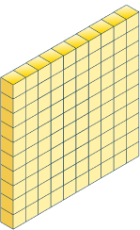
Starter
Who has made the number 436?
Explain how you know.
Yes
400 + 20 + 16 = 436
300 + 40 + 6 = 346
300 + 130 + 6 = 436
No
Yes
Answers
Notes:
Concrete resources – Base 10 equipment. Up until this lesson, place value counters have not been used as they do not show the relative sizes of numbers, and pupils
cannot see that 1 ten is made up of 10 ones. Place value counters will be introduced in this lesson during the main teaching.
Key Questions – How many hundreds/tens/ones are there? Can you write a number sentence to find the number that has been built by the Mathlings? How many ones do you need for them to be equivalent to 1 ten? How many tens do you need for them to be equivalent to 1 hundred? What happens if you have more than 10 ones? What happens if you have more than 10 tens? Can you make any exchanges in these representations?
Misconceptions/ Common Errors – Pupils may have difficulty exchanging when representations show more than ten of one part of a number. Pupils may not understand the value of each part of a number, for example confusing 240 and 204
Further Practice – Can you make 436 in a different way using your equipment?

Slide 7
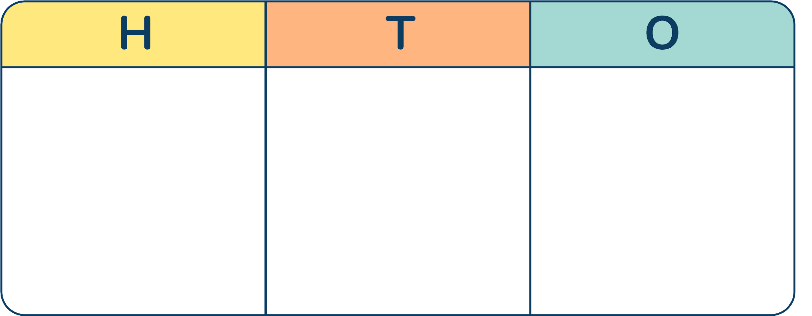
Let’s Learn
Which numbers are represented using the place value charts?
What is the same and what is different about these representations?
188
1
_____ is made up of _____ hundreds, _____ tens and _____ ones.
8
8
_____ is made up of _____ hundreds, _____ tens and _____ ones.
_____ can be made using _____ hundreds counters, _____ tens counters and _____ ones counters.
188
1
8
8
188
1
8
8
_____ is made up of _____ hundreds, _____ tens and _____ ones.
404
4
0
4
Answers
Notes:
Concrete resources – Place value counters and place value charts. Plain counters can also be used. Pupils should be encouraged to consider the similarities and differences between more familiar concrete resources, such as base 10, and place value counters.
Key Questions – What is the same about representing a number using base 10 and using place value counters? What is different? How do you know the value of the counter? How do you know which column to place the counter in? How many hundreds, tens and ones is _____ made up of? How can you use plain counters to represent a number in a place value chart? How do you write a number that has zero tens?
Misconceptions/ Common Errors –When working with place value counters, the fact that the physical size of the object does not reflect its value may cause some difficulties. Pupils may think that plain counters cannot be used to represent a number in a place value chart because they do not have a value written on them.
Further Practice – Give children different numbers to complete. Paired practice - one pupil makes a number and the other writes it down. Alternatively, children use number cards/dice to make three digit numbers that they need to create on the place value charts.

Slide 8
Follow Me
The number is 801.
Who is correct?
Explain your answer.
The number is 810.
The top Mathling is not correct. It has confused the value of the of the tens and ones. The bottom Mathling is correct because there are 8 hundreds, 1 ten and 0 ones. As there are no ones it added a placeholder zero in the ones column when writing the number.
8 hundreds + 1 ten + 0 ones = 810 800 + 10 + 0 = 810
Answers
Notes:
Concrete resources – Place value counters and place value charts. Plain counters can also be used. Pupils should be encouraged to consider the similarities and differences between more familiar concrete resources, such as base 10, and place value counters.
Key Questions – How do you know the value of the counter? How many hundreds, tens and ones is this number made up of? How can you use plain counters to represent a number in a place value chart? How do you write a number that has zero ones? If this place value chart shows 810, how could you show 801 using place value counters?
Misconceptions/ Common Errors – When working with place value counters, the fact that the physical size of the object does not reflect its value may cause some difficulties. Pupils may omit zeros needed as placeholders.

Slide 9
Your Turn
Notes:
364 is made up of 3 hundreds, 6 tens and 4 ones. 364 can be made using 3 hundreds counters, 6 tens counters and 4 ones counters.
250 is made up of 2 hundreds, 5 tens and 0 ones. 250 can be made using 2 hundreds counters, 5 tens counters and 0 ones counters.
703 is made up of 7 hundreds, 0 tens and 3 ones. 703 can be made using 7 hundreds counters, 0 tens counters and 3 ones counters.

Slide 10
Follow Me
Use a place value chart to represent each number.
615
308
Draw the missing counters to complete each place value chart.
497
150
Answers
Notes:
Concrete resources – Place value counters and place value charts. Plain counters can also be used. Pupils should be encouraged to consider the similarities and differences between more familiar concrete resources, such as base 10, and place value counters
Key Questions – Do we always need to have counters that have their value on them? How do you know the value of the counter? How do you know which column to place the counter in? How many hundreds, tens and ones is _____ made up of? How do you write a number that has zero tens? How do you write a number that has zero ones?
Misconceptions/ Common Errors – When working with place value counters, the fact that the physical size of the object does not reflect its value may cause some difficulties. Pupils may think that plain counters cannot be used to represent a number in a place value chart because they do not have a value written on them. Pupils may omit zeros needed as placeholders.

Slide 11
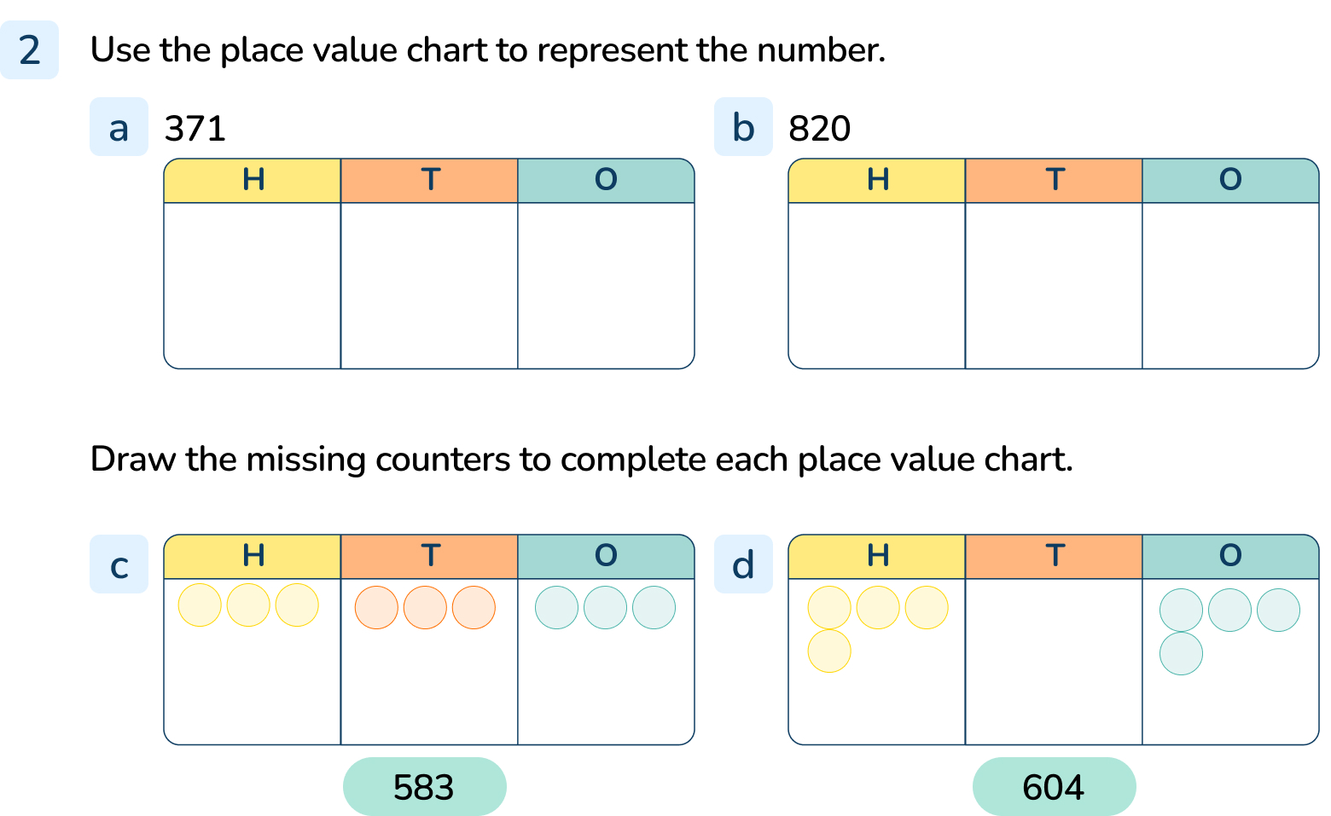
Your Turn
Notes:
3 hundreds, 7 tens, 1 one
8 hundreds, 2 tens
2 more hundreds, 5 more tens
3 more hundreds

Slide 12
Follow Me
How many numbers can you make with exactly 5 counters?
I have made a number with 5 counters to get you started.
Notes:
There are various possible answers. Encourage pupils to represent the number then describe it using the sentence stems they’ve used in the lesson
Concrete resources – Place value counters and place value charts. Plain counters can also be used.
Key Questions – What number is represented in the place value chart? How many hundreds, tens and ones are there? What other numbers can be made using exactly five counters? How many hundreds, tens and ones are there in each new number we can make? How can we work systematically to find all the possible numbers?
Misconceptions/ Common Errors – When working with place value counters, the fact that the physical size of the object does not reflect its value may cause some difficulties. Pupils may think that plain counters cannot be used to represent a number in a place value chart because they do not have a value written on them. Pupils may omit zeros needed as place holders.
Extension – Put the numbers you have created into ascending order. Choose 3 of the 3-digit numbers you have made and find 3 different ways to partition them. Write a number sentence to show each partition.

Slide 13
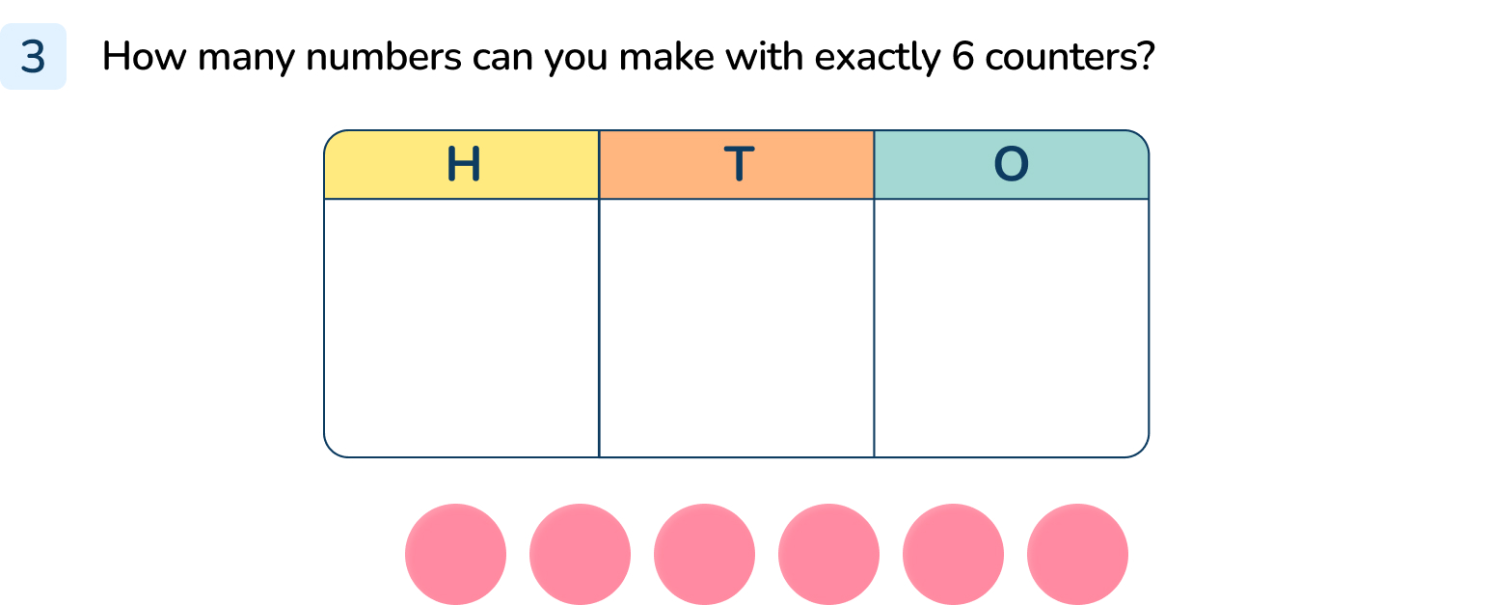
Your Turn
Notes:
Possible numbers are:
6
15, 24, 33, 42, 51, 60
105, 114, 123, 132, 141, 150
204, 213, 222, 231, 240
303, 312, 321, 330
402, 411, 420
501, 510
600

Slide 14
Let’s Reflect
The Mathlings are each thinking of a number.
2 hundreds + 9 tens + 4 ones = 294
200 + 90 + 4 = 294
2 hundreds + 4 tens + 9 ones = 249
200 + 40 + 9 = 249
My number is made up of 2 hundreds, 9 tens and 4 ones.
My number is made up of 2 hundreds, 4 tens and 9 ones.
Do you agree with this Mathling?
I think the Mathlings are thinking of the same number.
Green mathling is not correct, the numbers are different.
Answers
Notes:
Concrete resources – Place value counters and place value charts. Plain counters can also be used.
Key Questions – How many hundreds/tens/ones are there? Could you use a place value chart to help you read the numbers? Can you write a number sentence for each number the Mathlings are thinking about?
Misconceptions/ Common Errors – When working with place value counters, the fact that the physical size of the object does not reflect its value may cause some difficulties.

Slide 15
The following slides are based on: Using place value charts

Slide 16
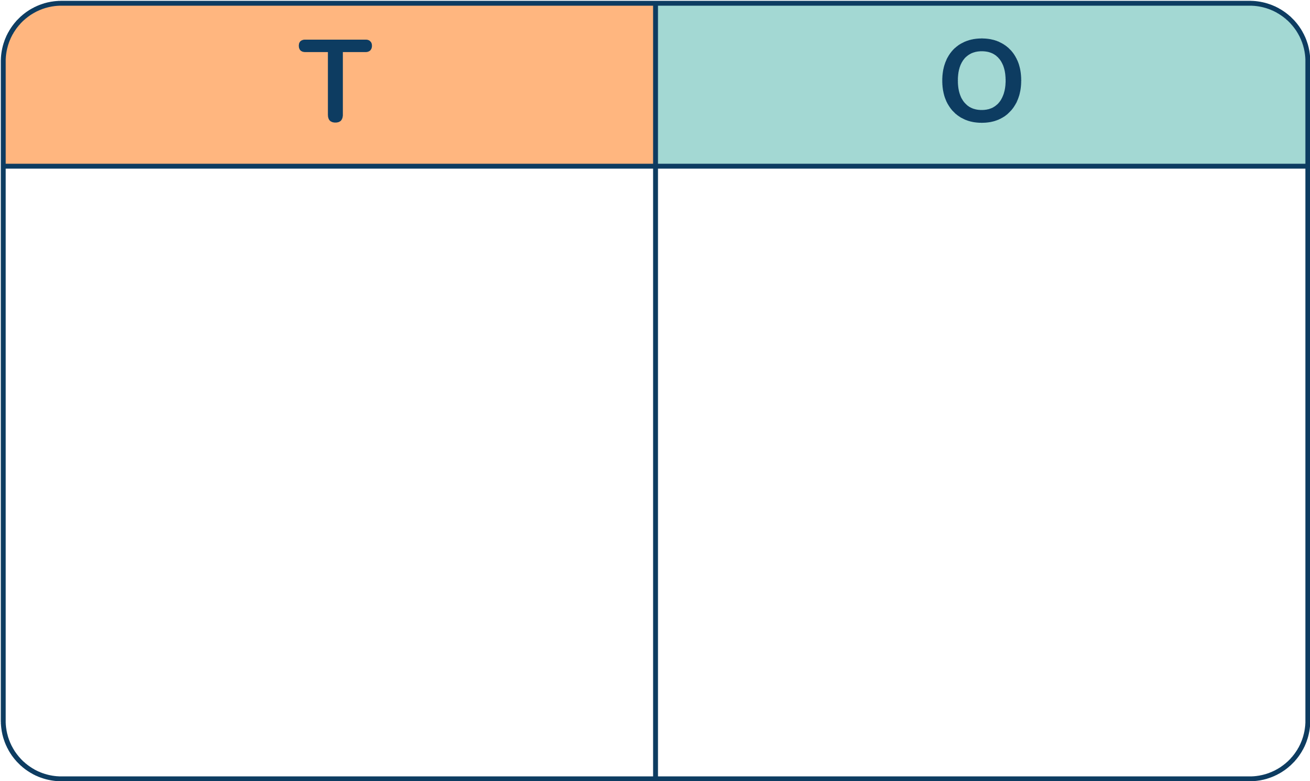
38
What number is shown?
Do you think the place value chart match the base 10 equipment?
Use counters to make a place value chart to match the base 10 representation.
Answers
Notes:
How and when to use these slides – These slides are based on the Y2 small step Use a place value chart. They enable pupils to practice organising equipment into the correct place value headings in a place chart, making explicit the link between the counters and the familiar base 10 equipment.
Concrete resources – Place value charts, base 10 and place value counters. Plain counters can be used.
Key Questions – How many tens are there? How many ones are there? How do we write a number with 3 tens and 8 ones? Where are the 3 tens shown in the place value chart? Where are the ones? Would it make any difference if the counters were plain and didn’t have a value printed on them? How would you know which counters represent the tens? How would you know which counters represent the ones? What is the same about representing a number using base 10 and using place value counters? What is different?
Misconceptions/ Common Errors – Pupils may not understand when the place value headings are presented differently, for example using “T” and “O” rather than “Tens” and Ones”. Pupils may write the whole number in a single column, rather than considering the structure of the number.
Further Practice – Build a number in base 10 for your partner to show using counters and a place value chart. Make a number using counters and a place value chart for your partner to build using base 10.

Slide 17
The Mathlings have each made a number in the place value chart.
Are their numbers the same?
Explain how you know.
4 tens + 2 ones
40 + 2 = 42
4 tens + 2 ones
40 + 2 = 42
The numbers are the same.
2 tens + 5 ones
20 + 5 = 25
2 tens + 6 ones
20 + 6 = 26
The numbers are not the same.
Answers
Notes:
How and when to use these slides – to support the deliberate practice of using place value counters and charts to make 2 digit numbers.
Concrete resources – Place value charts, base 10 and place value counters. Plain counters can be used.
Key Questions – How many tens are there? How many ones are there? How do you know which counters represent the tens? How do you know which counters represent the ones? What is the same about representing a number using base 10 and using place value counters? What is different? How many ones are equivalent to 1 ten? What should you do if you have 10 or more ones in the ones column? Do you need to make an exchange to find out if the numbers are the same?
Misconceptions/ Common Errors – Pupils may not understand when the place value headings are presented differently, for example using “T” and “O” rather than “Tens” and Ones”. Pupils may write the whole number in a single column, rather than considering the structure of the number.

