Slide 1
Year 3
Place Value
To know how to estimate the position of a number on a number line

Slide 2
Summary
Key Vocabulary and Sentence Stems
Diagnostic Question
Learning Objective
Starter – Labelling numbers on number lines with different intervals
Let’s Learn
Follow Me – Estimate positions on number lines that lie on the midpoint between two marked divisions.
Your Turn (1) – Estimate positions on number lines that lie on the midpoint between two marked divisions.
Follow Me – Estimate positions on a number line using the midpoint as a reference point.
Your Turn (2) – Estimate positions on a number line using the midpoint as a reference point.
Follow Me – Reasoning and problem solving
Your Turn (3) – Reasoning and problem solving
Let’s Reflect
Support Slides – Based on estimate numbers on a number line to 100

Slide 3
Key Vocabulary
number line | estimate
hundreds | tens
ones | Intervals
Sentence Stems
(number) is closer to (number) than (number), so the position of (number) on the number line is closer to (number) than (number).
(number) is more/less than halfway along the interval, so the position of (number) is closer to (number).

Slide 4
Where would 256 be on the number line?
240
260
Notes:
Assessment point for the lesson – ask the pupils to vote for the answer they think is correct.
A – Pupil has chosen the halfway point of the number line - 250. The pupil may know of the strategy to use the halfway point to guide an estimate, but they cannot apply it correctly.
B – Correct answer
C – Pupil has chosen a point within the first half of the number line which would be a number less than 250. The pupil may not know of the strategy to use the halfway point to guide an estimate.
D – Pupil has chosen a point after the halfway point on the number line which would be a number greater than 250, however the pupil has not used the end point of 260 to help them to position 256. The pupil may know of the strategy to use the halfway point to guide an estimate, but they cannot apply it correctly.

Slide 5
To estimate the position of a number on a number line

Slide 6
Starter
Label 300 on each number line.
What do you notice?
0
100
200
300
400
500
600
700
800
900
1,000
200
300
400
500
600
700
800
280
282
284
286
288
290
292
294
296
298
300
302
304
306
308
300 is in a different position on each number line because the three number lines have different start and end points and the intervals are different sizes.
Answers
Notes:
Concrete resources – Number lines. Remind pupils of the benefit of always starting by labelling the divisions on their number line.
Key Questions – What is the start point? What is the end point? How many intervals are there? What is each interval worth? What is the number line counting up in? How do you know? Where would 300 be on the number line? How do you know? Explain why 300 is on a different division on each number line.
Misconceptions/ Common Errors – Pupils may assume that all number lines count in 1s, 10s or 100s and hence incorrectly label the divisions. Pupils may count the number of divisions, rather than the intervals. Pupils may incorrectly count the number of intervals and therefore label the positions of numbers incorrectly. Pupils may just look at the end point of the number line rather than both the start and end to find the difference.
Extension – Is there a number that can ONLY be shown on the first number line? How do you know?

Slide 7
Let’s Learn
Estimate the number that the arrow is pointing to.
500
510
520
530
540
550
560
570
580
590
600
500
502
504
506
508
510
512
514
516
518
520
The interval is 10. The arrow is pointing halfway between 540 and 550. The arrow is pointing to 545.
The interval is 2. The arrow is pointing halfway between 508 and 510. The arrow is pointing to 509.
Answers
Notes:
Discuss estimation in this part of the lesson – when do you estimate? Why?
Concrete resources – blank number lines. Remind pupils of the benefit of always starting by labelling the divisions on their number line.
Key Questions – What is the start point? What is the end point? How many intervals are there? What is each interval worth? What is the number line counting up in? How do you know? Which divisions is the arrow between? How do you know? If the arrow is halfway between the two divisions, how can you estimate the number it is pointing at?
Misconceptions/ Common Errors – Pupils may assume that all number lines count in 1s, 10s or 100s and hence incorrectly label the divisions. Pupils may count the number of divisions, rather than the intervals. Pupils may incorrectly count the number of intervals and therefore label the positions of numbers incorrectly. Pupils may just look at the end point of the number line rather than both the start and end to find the difference.
Further Practice – Draw additional arrows on the number lines to offer more practice in finding numbers at the midpoint between divisions.

Slide 8
Follow Me
Estimate the number that the arrow is pointing to.
775
700
710
720
730
740
750
760
770
780
790
800
365
340
350
360
370
380
390
400
410
420
430
640
171
160
162
164
166
168
170
172
174
176
178
180
Answers
Notes:
Concrete resources – blank number lines. Remind pupils of the benefit of always starting by labelling the divisions on their number line.
Key Questions – What is the start point? What is the end point? How many intervals are there? What is each interval worth? What is the number line counting up in? How do you know? Which divisions is the arrow between? How do you know? If the arrow is halfway between the two divisions, how can you estimate the number it is pointing at?
Misconceptions/ Common Errors – Pupils may assume that all number lines count in 1s, 10s or 100s and hence incorrectly label the divisions. Pupils may count the number of divisions, rather than the intervals. Pupils may incorrectly count the number of intervals and therefore label the positions of numbers incorrectly. Pupils may just look at the end point of the number line rather than both the start and end to find the difference.
Further Practice – Draw additional arrows on the number lines to offer more practice in finding numbers at the midpoint between divisions.

Slide 9
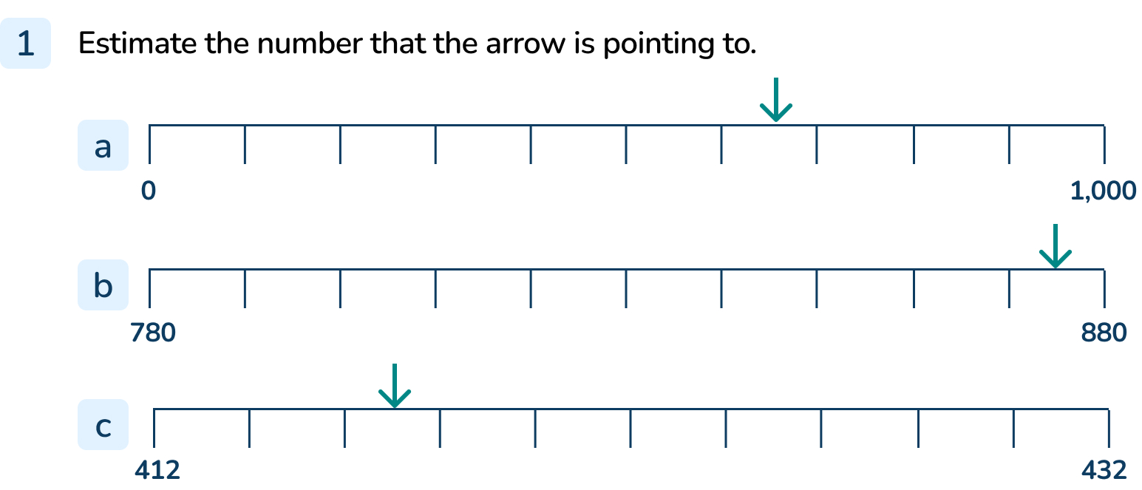
Your Turn
Notes:
650
875
417

Slide 10
Follow Me
Estimate the numbers that the arrows are pointing to.
Explain how you know.
381 387 412
340
350
360
370
380
390
400
410
420
430
440
Estimate where the numbers belong on the number line.
380
Five hundred and ten
925
0
100
200
300
400
500
600
700
800
900
1,000
Answers
Notes:
Concrete resources – blank number lines. Remind pupils of the benefit of always starting by labelling the divisions on their number line.
Key Questions – What is the start point? What is the end point? How many intervals are there? What is each interval worth? What is the number line counting up in? How do you know? Which divisions is the arrow between? How do you know? If the arrow is halfway between the two divisions, how can you estimate the number it is pointing at? If the arrow is very close to a division, what would be a sensible estimate of the number? Is _____ closer to _____ or _____ ? How do you know? How accurate do you think your estimate is? How could you be more accurate?
Misconceptions/ Common Errors – Pupils may assume that all number lines count in 1s, 10s or 100s and hence incorrectly label the divisions. Pupils may count the number of divisions, rather than the intervals. Pupils may incorrectly count the number of intervals and therefore label the positions of numbers incorrectly. Pupils may just look at the end point of the number line rather than both the start and end to find the difference.
Further Practice – Draw additional arrows on the number lines to offer more practice in finding numbers using the midpoint between divisions as a reference point to refine estimates.

Slide 11
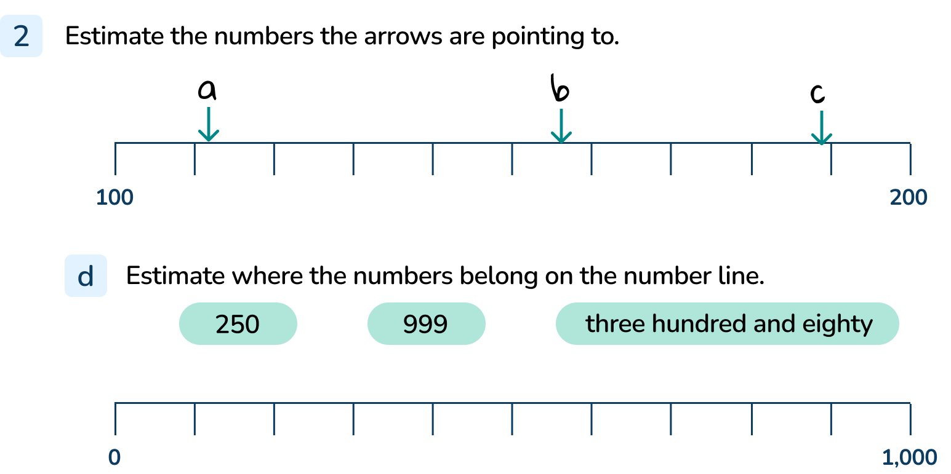
Your Turn
Notes:
111
156
189
Arrows should be positioned appropriately.

Slide 12
Follow Me
Here is a number line from 0 to 1,000.
Estimate where the numbers belong on the number line.
0
1,000
100
250
430
500
780
999
Notes:
Discuss reasonable estimates for the positions of the numbers. Explain that we cannot be certain of the position and discuss why.
Concrete resources – blank number lines. Remind pupils of the benefit of always starting by labelling the divisions on their number line.
Key Questions – What is the start point? What is the end point? There are no divisions on this number line, would it help to find the midpoint? What number is at the midpoint on this number line? Once you have placed 500, does that make it easier to estimate any of the other numbers? Why? Is _____ closer to _____ or _____ ? How do you know? How accurate do you think your estimates are? How could you be more accurate?
Misconceptions/ Common Errors – Pupils may just look at the end point of the number line rather than both the start and end to find the difference.
Extension – Compare your answers with a partner. Your answers may not be exactly the same. Explain why you can only estimate on this number line.
Which number was the easiest to estimate? Explain your reasoning. (There are no divisions shown on the number line but 500 was easy to estimate because it is the midpoint. 999 was easy because it is only 1 less than 1,000.)

Slide 13
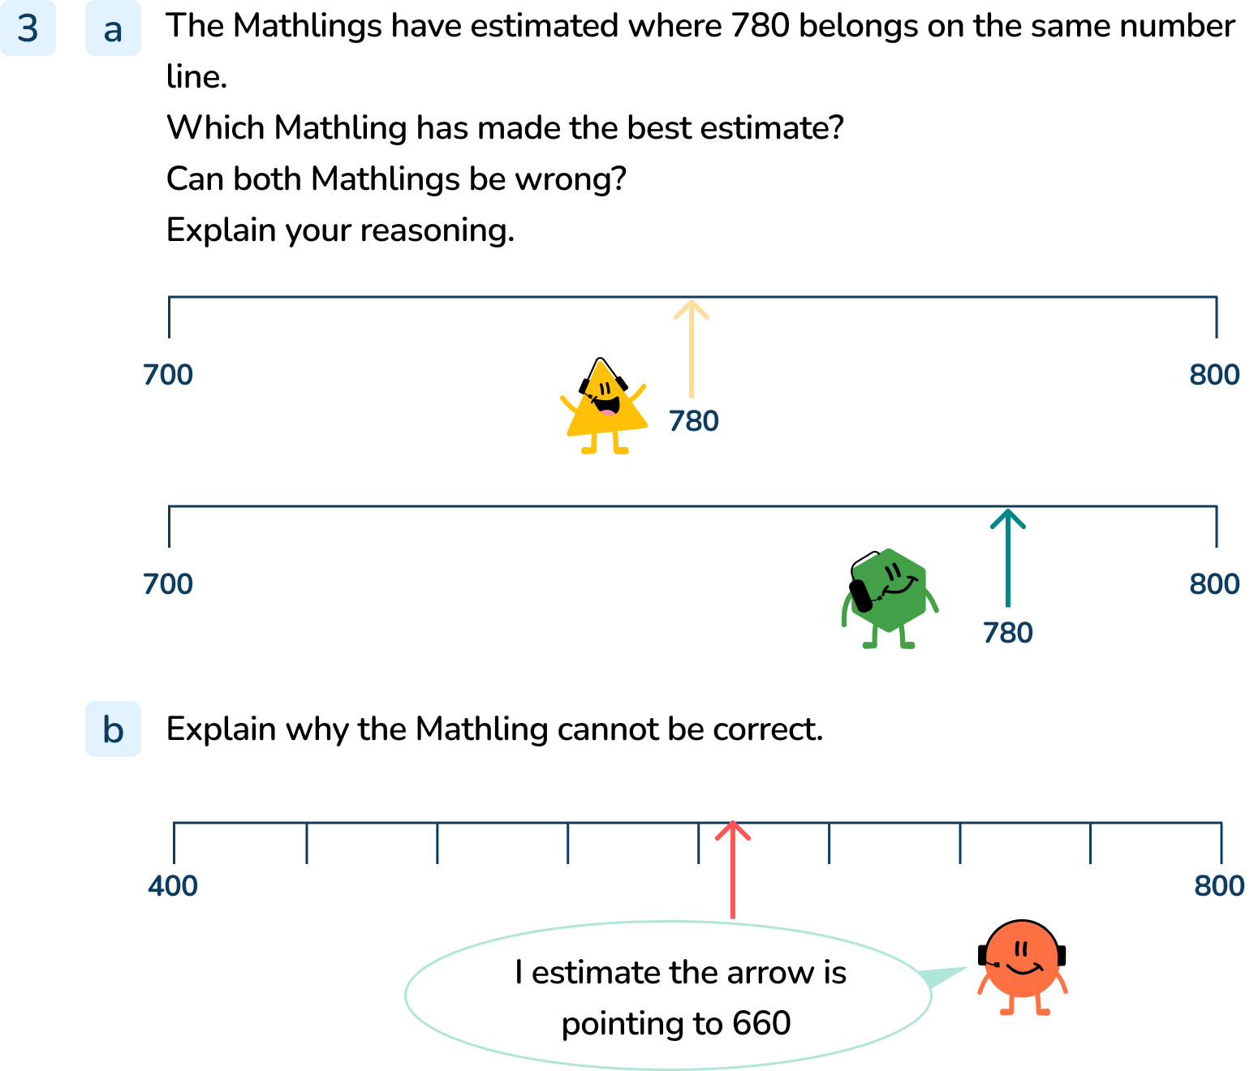
Your Turn
Notes:
The first Mathling is unlikely to be correct because the yellow arrow is close to the midpoint of the line. The number at the midpoint is 750. This Mathling has probably put his arrow at 760. The other Mathling has put his arrow further away from the midpoint 750. It is more likely to be correct. Both Mathlings are estimating the position of 780, so it is possible that neither of them have put their arrow at exactly 780.
The Mathling is not correct. The number line starts at 400 and ends at 800. The interval is 50. The Mathling’s arrow is between 600 and 650 but is closer to 600. Its arrow might be pointing to 610.

Slide 14
Let’s Reflect
These shapes show the positions of four numbers on the number line.
Match the shapes to the numbers.
Explain your reasoning.
390
50
370
four hundred and twelve
0
100
200
300
400
500
600
700
800
900
1,000
370
four hundred and twelve
390
fifty
Answers
Notes:
Concrete resources – blank number lines. Remind pupils of the benefit of always starting by labelling the divisions on their number line.
Key Questions – How many intervals are there? What is each interval worth? What is the number line counting up in? How do you know? Which divisions is the red triangle between? How do you know? If the arrow is halfway between the two divisions, how can you estimate the number it is pointing at? If the arrow is very close to a division, what would be a sensible estimate of the number? Is _____ closer to _____ or _____ ? How do you know? How accurate do you think your estimate is? How could you be more accurate?
Misconceptions/ Common Errors – Pupils may assume that all number lines count in 1s, 10s or 100s and hence incorrectly label the divisions. Pupils may count the number of divisions, rather than the intervals. Pupils may incorrectly count the number of intervals and therefore label the positions of numbers incorrectly. Pupils may just look at the end point of the number line rather than both the start and end to find the difference.

Slide 15
The following slides are based on: Estimate numbers on a number line to 100

Slide 16
Label the number lines.
Estimate where each number belongs on the line.
25
55
eighty-five
0
10
20
30
40
50
60
70
80
90
100
25
eighty-five
55
Estimate the numbers the arrows are pointing to.
15
41
97
0
10
20
30
40
50
60
70
80
90
100
Answers
Notes:
How and when to use these slides – These slides are based on the Y2 small step Estimate numbers on a number line. They offer pupils practice to consolidate their understanding of the exact positions of numbers on the number line to 100, focusing first on multiples of 10 and then to estimate the values in between.
Concrete resources – Number lines. Remind pupils of the benefit of always starting by labelling the divisions on their number line.
Key Questions – What is the start point? What is the end point? How many intervals are there? What is each interval worth? What is the number line counting up in? How do you know? Where would the mid-point be on the number line? How do you know? Which divisions is _____ between? How will you estimate where these number are?
Misconceptions/ Common Errors – Pupils may assume that all number lines count in 1s and hence incorrectly label the divisions. Pupils may count the number of divisions, rather than the intervals. Pupils may incorrectly count the number of intervals and therefore label the positions of numbers incorrectly. Pupils may just look at the end point of the number line rather than both the start and end to find the difference.
Further Practice – Draw additional arrows on the number lines to offer more practice in finding numbers at the midpoint between divisions and then at any point between divisions.

Slide 17
Estimate where the number 46 would belong on each number line.
Explain your answers.
0
46
100
0
46
50
40
46
50
Answers
Notes:
Concrete resources – Number lines. Remind pupils of the benefit of always starting by labelling the divisions on their number line
Key Questions – What is the start point? What is the end point? Where would the midpoint be on the number line? How do you know? What number is at the midpoint? How do you know? Is 46 closer to _____ or _____? How accurate do you think your estimates are? How could you be more accurate? How can 46 be in a different position on each number line?
Misconceptions/ Common Errors – Pupils may just look at the end point of the number line rather than both the start and end to find the difference.
Further Practice – Estimate the position of 41, 44 and 49 on each number line.

