Slide 1
Year 1
Place Value (within 10)
To understand how to write numbers in words

Slide 2
Summary
Key Vocabulary and Sentence Stems
Diagnostic Question
Learning Objective
Starter – Matching numerals and objects
Let’s Learn
Follow Me – Match number of fingers to words
Your Turn (1) – Match number of counters to words
Follow Me – Write words in numerals
Your Turn (2) – Draw number of objects
Follow Me – Missing number words in number track
Your Turn (3) – Missing number words in number tracks
Let’s Reflect
Support Slides – Based on matching groups to numerals

Slide 3
Key Vocabulary
one | two
three | four
five | six
seven | eight
nine | ten
zero

Slide 4
What is the missing number?
two | 2
four | 4
ten | ?
5
6
10
one
Notes:
Assessment point for the lesson – ask the pupils to vote for the answer they think is correct.
A – Pupils have not read the word and just followed on from 4.
B – Pupils have counted in 2s and not read the word..
C –Correct Answer
D – Pupils have not understood how to read numbers in words.

Slide 5
To write numbers in words

Slide 6
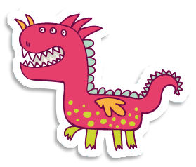
Starter
Write the numeral to match each set of objects.
4
6
9
Answers
Notes:
Concrete resources – Tens frames and items
Key Questions – How many (buttons etc) would we need to fill the tens frame? How many would there be if I filled the top row? What number do we start with when counting?
Misconceptions/ Common Errors – Counting starting with 0. Counting items more than once.

Slide 7
Let’s Learn
Match the numeral to the words.
5
6
2
8
7
9
seven
two
nine
six
five
eight
Answers
Notes:
Concrete resources – number cards, words
Key Questions – How many words can you match to the numerals? Which word begins with the letter “n”? Which numeral does this match? Does the greatest number always have the most letters in the word?
Misconceptions/ Common Errors – Pupils may get the words that start with the same letter , for example four/five and six/seven, confused. Pupils may struggle to associate the sound of the word eight with the spelling. In contrast, they may find six easier due to it starting with the “ssss” sound. Seven is the only two-syllable word, but it has the same number of letters as three and eight. Pupils may find this confusing and look for a longer word for 7.
Further Practice – Match different words and numerals.

Slide 8
Follow Me
How many fingers are there?
Match the fingers to the words.
four
one
zero
three
five
five
four
three
zero
one
Answers
Notes:
Concrete resources – cubes, counters
Key Questions – How many words can you match to the numerals? Which word begins with the letter “z”? Which numeral does this match? Does the greatest number always have the most letters in the word? Does the smallest number always have the fewest letters in the word?
Misconceptions/ Common Errors – Children are likely to be confident with the words one, two and three, but may get mixed up after this point. In particular, words that start with the same letter, for example four/five and six/seven, can cause confusion.
Extension – Write the words without the cards

Slide 9
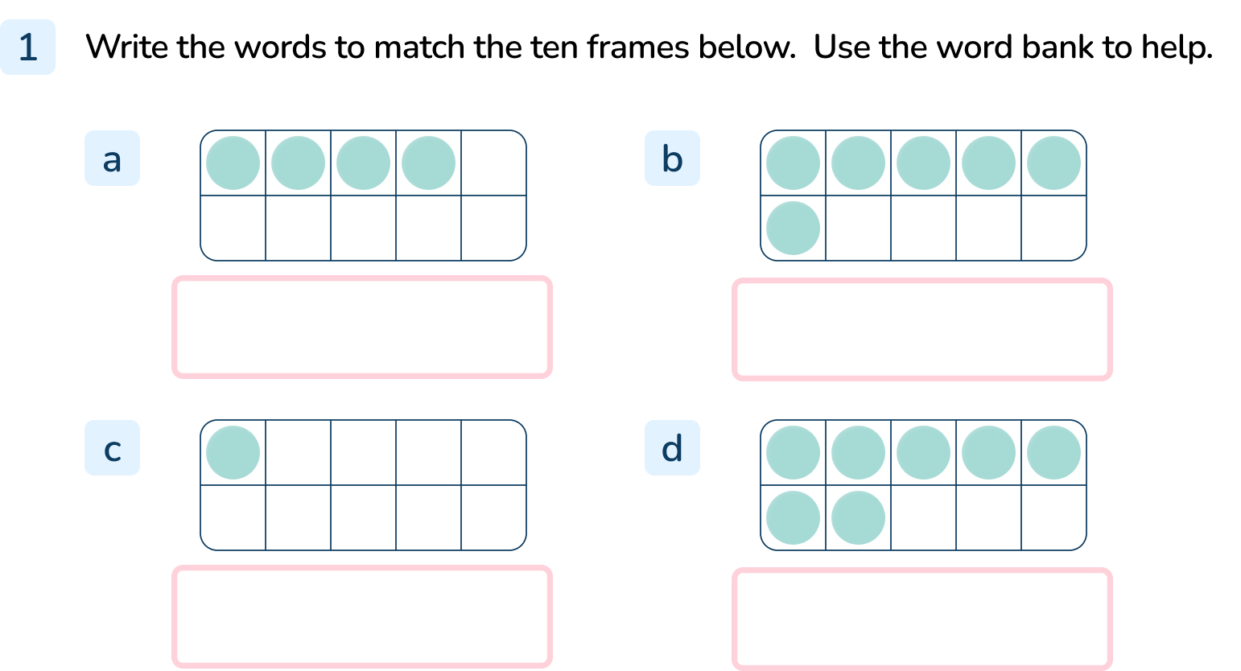
Your Turn
Notes:
Four
Six
One
Seven

Slide 10
Follow Me
Write the words in numerals.
7
8
seven
eight
4
0
four
zero
Answers
Notes:
Concrete resources – number cards
Key Questions – what do the words say? Which numbers begin with f? Which number starts with z? Does the greatest number always have the most letters in the word? Does the smallest number always have the fewest letters in the word?
Misconceptions/ Common Errors – Pupils may struggle to associate the sound of the word eight with the spelling. In contrast, they may find six easier due to it starting with the “ssss” sound. Seven is the only two-syllable word, but it has the same number of letters as three and eight. Pupils may find this confusing and look for a longer word for 7.
Further Practice – further words and numbers

Slide 11
Your Turn
Notes:
6 buttons
5 cakes
9 triangles
2 counters

Slide 12
Follow Me
The Mathling is making a number track.
Which numbers are missing?
zero |  | two | three |  |  | six |  | eight | nine
 | one |  |  | four | five |  | seven |  |  | ten
zero
one
two
three
four
five
six
seven
eight
nine
ten
Answers
Notes:
Concrete resources – word bank, number tracks
Key Questions – How do we count from 0 - 10? What comes next? What letter does that start with? Does the greatest number always have the most letters in the word? Does the smallest number always have the fewest letters in the word?
Misconceptions/ Common Errors – Pupil are likely to be confident with the words one, two and three, but may get mixed up after this point. In particular, words that start with the same letter, for example four/five and six/seven, can cause confusion.
Further Practice – Different words missing
Extension – Blank number track to fill in.

Slide 13
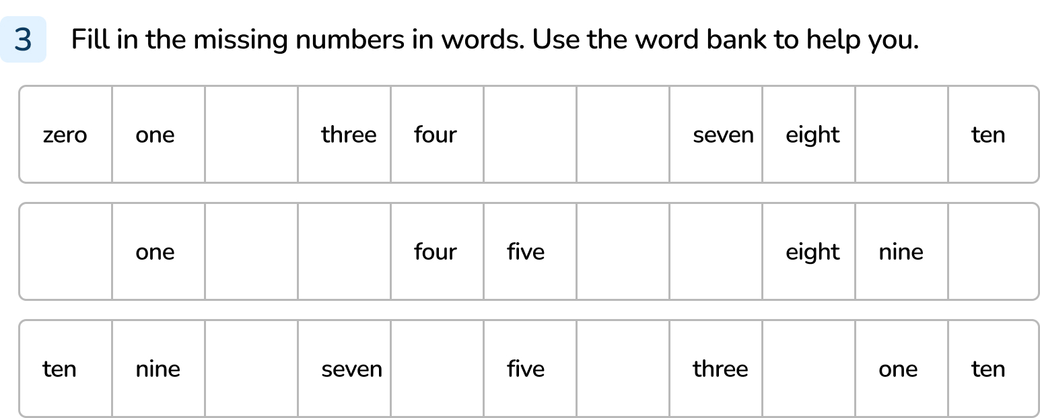
Your Turn
Notes:
Two, five, six, nine
Zero, two, three, six, seven, ten
Eight, six, four, two, zero

Slide 14
Let’s Reflect
Use the cards to complete the grid.
0 |  | 2 |  |  | 5 |  |  | 8 |  | 10
 | one |  | three | four |  | six | seven |  | nine
 | 1 |  | 3 | 4 |  | 6 | 7 |  | 9
zero |  | two |  |  | five |  |  | eight |  | ten
one
nine
0
four
three
10
2
six
5
seven
8
Answers
Notes:
Concrete resources – number cards, number track
Key Questions – How do we count from 0 - 10? What comes next? What letter does that start with? Does the greatest number always have the most letters in the word? Does the smallest number always have the fewest letters in the word? How do you write the numeral 5/8/10?
Misconceptions/ Common Errors – Pupil are likely to be confident with the words one, two and three, but may get mixed up after this point. In particular, words that start with the same letter, for example four/five and six/seven, can cause confusion.
Further Practice – Different words/numerals missing
Extension – create your own missing track for a partner to complete, without the cards.

Slide 15
The following slides are based on:
Matching groups to numerals

Slide 16
Match the numeral to the group.
3
5
8
2
Answers
Notes:
How and when to use these slides – Some pupils may struggle to recognise numbers in words. If they do, use these slides to ensure they understand how to match numbers to objects.
Concrete resources – manipulatives, cubes, counters
Key Questions – how many bears/bicycles/balls/lemons are there? Can you count them? Which number matches the bears? Which number matches the lemons? Can you draw objects to match the number 6?
Misconceptions/ Common Errors – Pupils may miscount the number of objects. They may not recognise the numbers.
Further Practice – Draw objects to match a given number.

Slide 17
Circle the correct number in each group.
5 7 2
0 4 6
1 5 9
4 7 0
Answers
Notes:
Concrete resources – manipulatives, cubes, counters
Key Questions – how many strawberries are there? Which number is the number four? How many buses are there? What does the last group show? How would you draw objects to match the number 9?
Misconceptions/ Common Errors – Pupils may miscount the number of objects. They may not recognise the numbers.
Further Practice – Draw objects to match a given number.

