Slide 1
Year 4
Place Value
To know how to represent numbers to 10,000

Slide 2
Summary
Key Vocabulary and Sentence Stems
Diagnostic Question
Learning Objective
Starter – Which representation shows the given number
Let’s Learn
Follow Me – Representations using Base 10
Your Turn (1) – Representations using Base 10
Follow Me – Representations using place value counters and chart
Your Turn (2) – Representations using place value counters and chart
Follow Me – Missing place value counters
Your Turn (3) – Missing place value counters
Let’s Reflect
Support Slides – Based on the value of thousands, hundreds, tens and ones

Slide 3
Key Vocabulary
thousands | hundreds
tens | ones
Sentence Stems
There are ten hundreds in one thousand.
There are one hundred tens in one thousand.
There are one thousand ones in one thousand.
There are (digit) thousand(s), (digit) hundred(s), (digit) ten(s) and (digit) one(s). The number is (total).
There are 2 thousands, 5 hundreds, 3 tens and 9 ones. The number is 2,539.

Slide 4
Which number is represented by the place value counters?
3,251
2,251
2,531
3,521
Notes:
Assessment point for the lesson – ask the pupils to vote for the answer they think is correct.
A – Correct answer
B – The pupil has not included the third thousands counter in their final number.
C – The pupil has counted the tens as hundreds and hundreds/ final thousand as tens.
D – The pupil has counted the thousands and ones correctly but has confused the hundreds and tens.

Slide 5
To represent numbers to 10,000

Slide 6
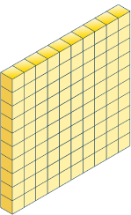
Starter
Which representation shows the number below?
216
They both show 216.
Answers
Notes:
Concrete resources – Base 10
Key Questions – Which numbers are represented? How do you know? How many ones make 1 ten? How many tens make 1 hundred? How can this help explain why both representations show 216?
Misconceptions/ Common Errors – Pupils may say the first image only represents 216.

Slide 7
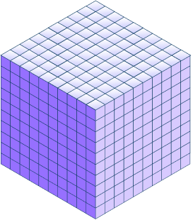
Let’s Learn
We can use Base 10 to represent numbers up to 10,000.
Use Base 10 to make this number, explain how you know this represents your number.
5,247
Notes:
Use Base 10 with pupils to make 5,247. This is an opportunity to discuss the relative size of numbers. Pupils may try to partition in different ways (e.g. 4 thousands, 12 hundreds) but encourage basic partitioning into thousands/ hundreds/ tens/ ones to ensure they understand the value of each digit in a number.
Concrete resources – Base 10
Key Questions – How many thousands/ hundreds/ tens/ ones are in this number? How many of each type of Base 10 will you need? How do you know? What do you notice about the way you have made the number?
Misconceptions/ Common Errors – Pupils may use incorrect resources (e.g. using all ones).
Extension – How would I use Base 10 to show 5,047? How is this similar or different to the representation on the side?

Slide 8
Follow Me
Which number is represented by the Base 10?
2
4
9
0
Answers
Notes:
Concrete resources – Base 10
Key Questions – How many thousands cubes are there? How many hundreds are there? How many tens are there? Are there any ones? How do you represent there being no ones?
Draw attention to the fact that the Base 10 and the place value chart are colour coded e.g. thousands are purple.
Misconceptions/ Common Errors – Pupils may write 249, showing they don’t understand the value of 0 as a place holder.
Further Practice – Add ones, how does this change the number?

Slide 9
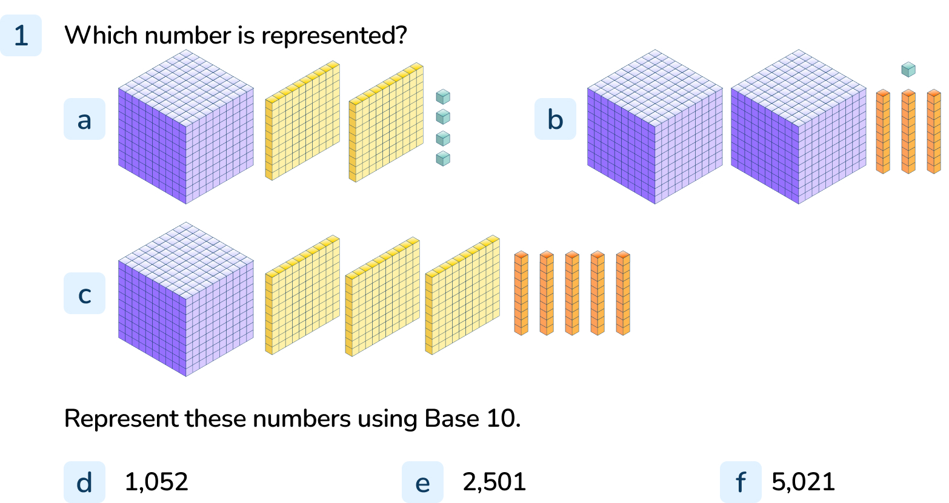
Your Turn
Notes:
1,204
2,031
1,350
To f) Base 10 should be used to accurately represent the given numbers.

Slide 10
Follow Me
Sometimes, with larger numbers, it’s easier to use place value counters to represent numbers.
Which number is represented by the place value counters?
6,236
Answers
Notes:
Concrete resources – Place Value counters (they can be in a place value chart or not)
Key Questions – How many thousands/ hundreds/ tens/ ones are there? What is the difference between the value of the digit 6 in this number as it appears twice?
Misconceptions/ Common Errors – Pupils may say that the hundreds column has a value that is less than all the other columns as there are only 2 counters in this column. Ensure pupils understand the relative size of numbers.
Extension – Can I move one thousand counter into the hundreds column? Why/ why not? Would this change the number represented?

Slide 11
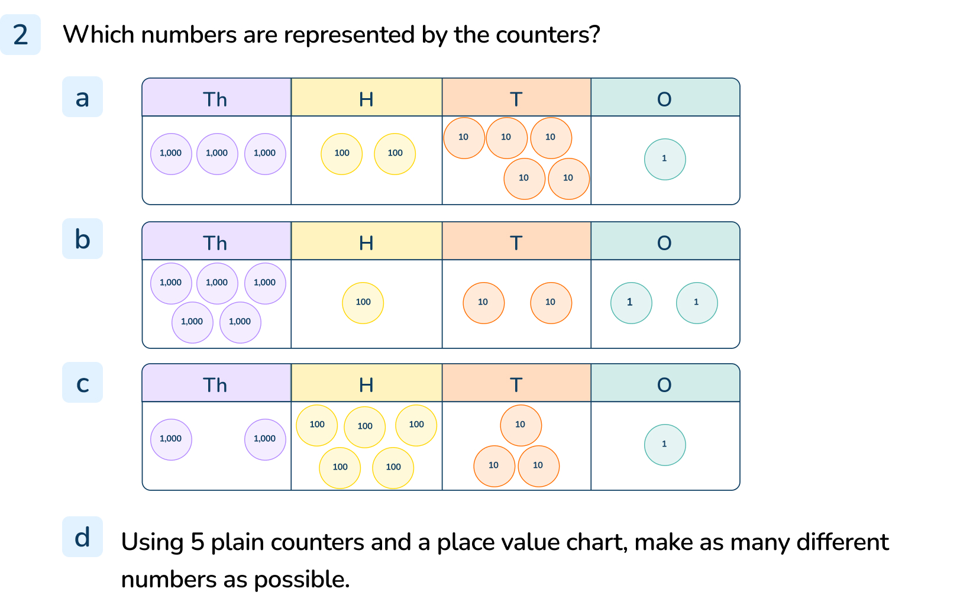
Your Turn
Notes:
3,251
5,122
2,531
Various answers, example answers: 5,000; 4,100; 4,010; 3,200; 1,211

Slide 12
Follow Me
Some place value counters are missing.
The total is six thousand, two hundred and ninety-three.
Which counters are missing?
Answers
Notes:
Concrete resources – Place value counters
Key Questions – Which counters can you see? What is the total of the counters you can see? How many ones/ tens/ hundreds/ thousands are missing? How do you know?
Misconceptions/ Common Errors – Pupils may find the total od the counters they can see but not know how to apply this to the question.

Slide 13
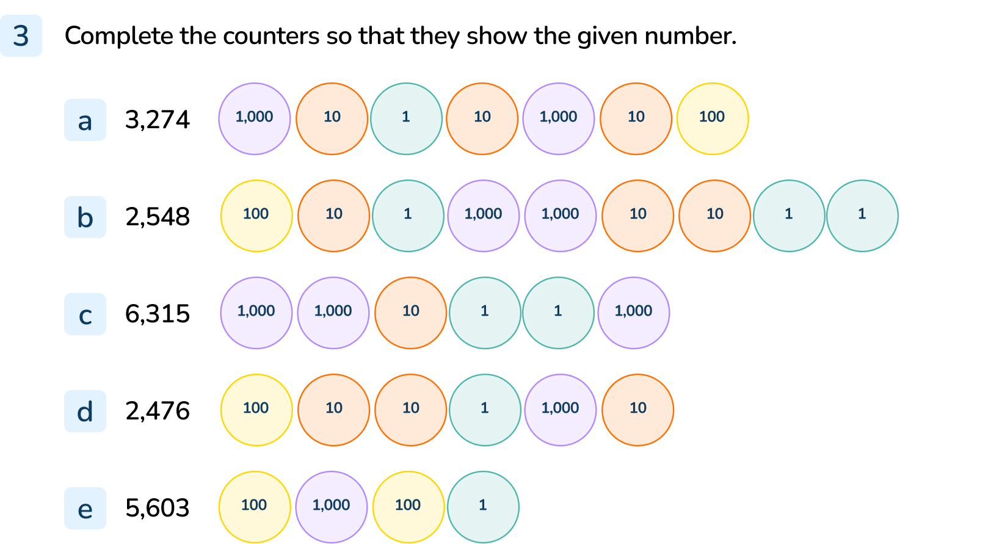
Your Turn
Notes:
The following counters should be added:
1 thousand, 1 hundred, 4 tens, 3 ones
4 hundreds, 1 ten, 5 ones
3 thousands, 3 hundreds, 3 ones
1 thousand, 3 hundreds, 4 tens, 5 ones
4 thousands, 4 hundreds, 2 ones

Slide 14
Let’s Reflect
Explain the mistake in this representation.
5,062
There shouldn’t be any hundreds counters.
Answers
Notes:
Concrete resources – Place value counters
Key Questions – How many thousands/ hundreds/ tens/ ones are there in the number? How would you represent the number? How is your way different to the one shown?
Extension – Represent 5,062 and make a different mistake. Explain your mistake.

Slide 15
The following slides are based on: The value of thousands, hundreds, tens and ones

Slide 16
How many ones make 1 ten?
How many tens make 1 hundred?
How many hundreds make 1 thousand?
Use the Base 10 to help explain your answers.
Notes:
How and when to use these slides – Use these slides to ensure pupils have a strong understanding of the relative size of numbers using concrete resources.
Concrete resources – Base 10 equipment
Key Questions – How many ones cubes would I need to make 1 ten? How many ones would I need to make 1 hundred/ 1 thousand? How do you know? Which has the larger value, 1 ten or 1 one? Which has the larger value 5 tens or 7 ones?
Misconceptions/ Common Errors – Pupils may say the column with the largest digit has the greatest value (e.g. 4 ones is greater than 1 hundred).
Further Practice – Make a number using the Base 10, possibly using the same digits to demonstrate that when the digits move in a number, the value of the digit changes.

Slide 17
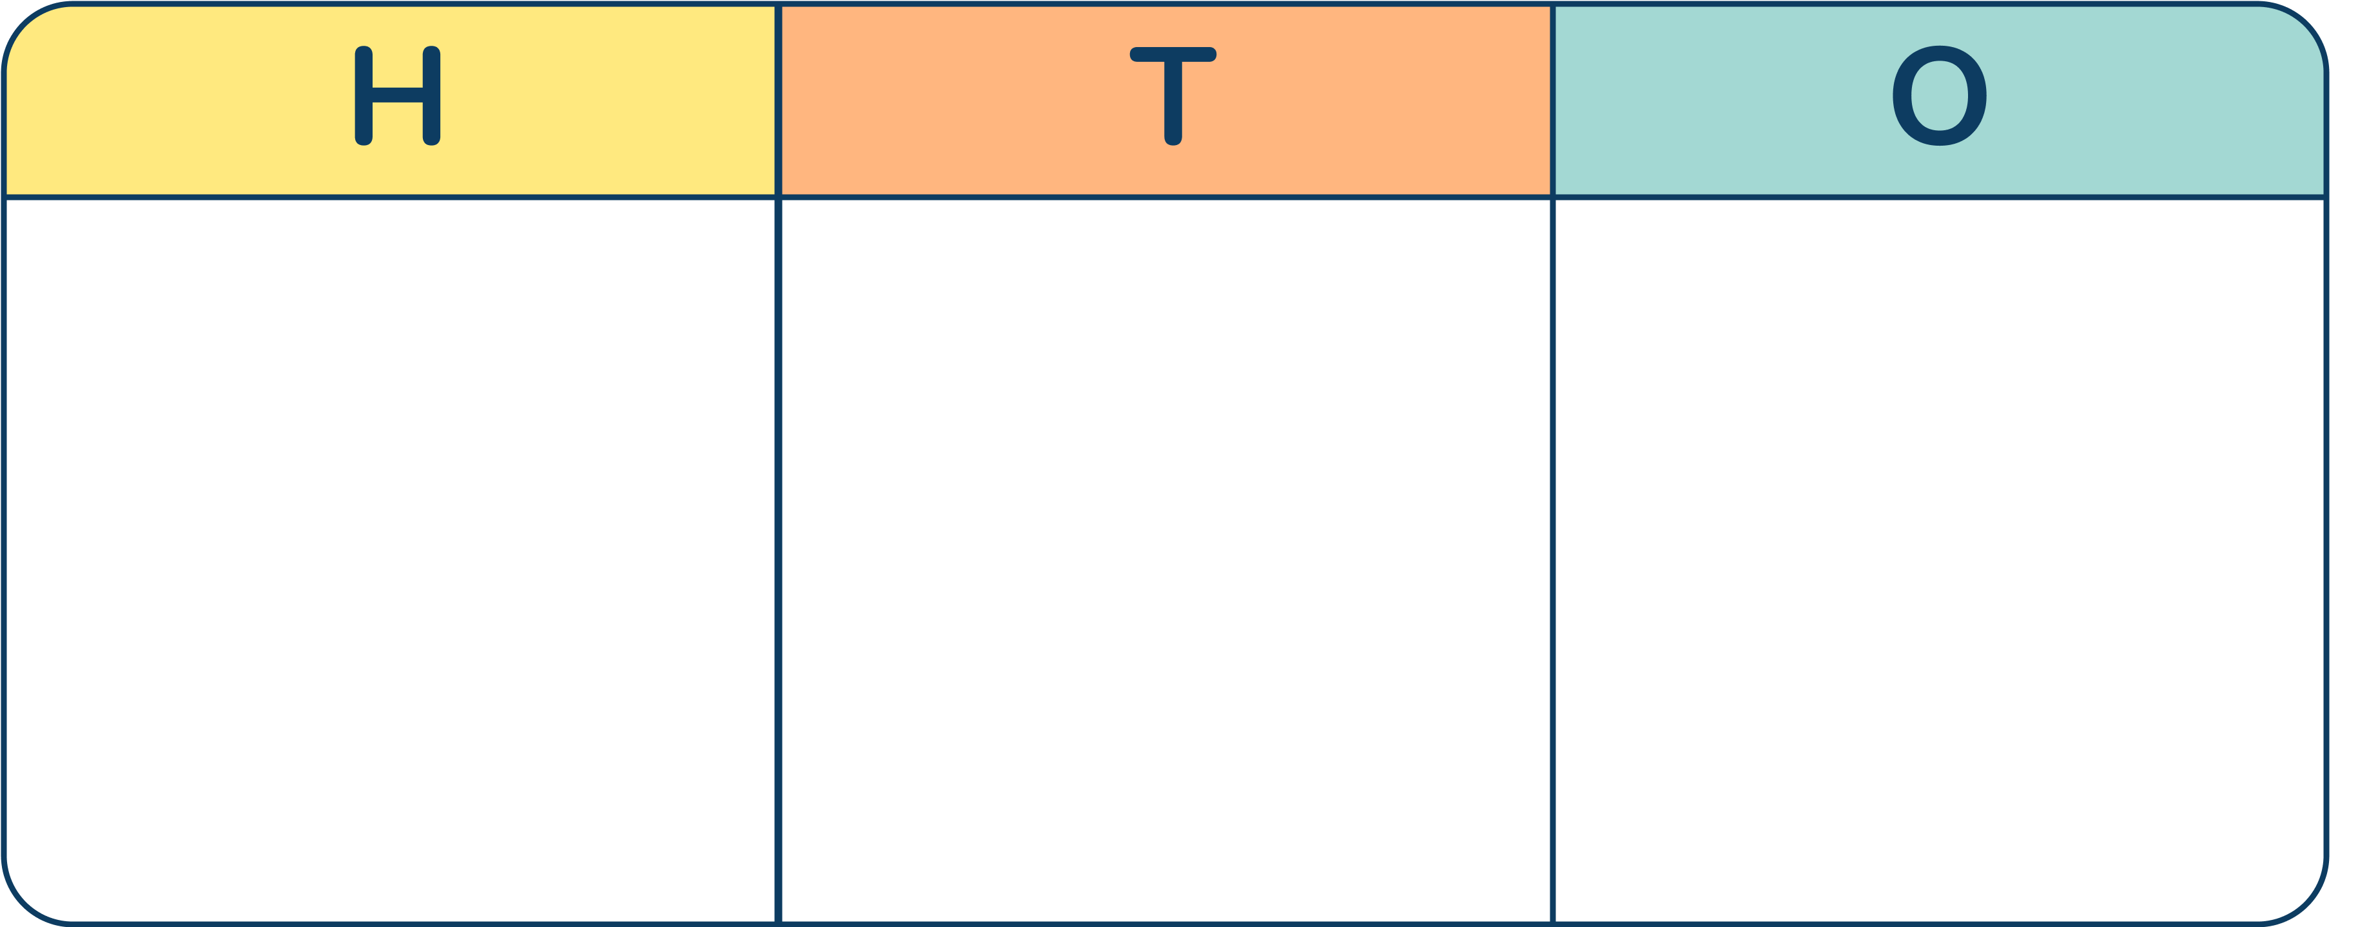
The Mathling has made this number.
It says, ”The tens column as the most counters, so the tens column has the highest value.”
Do you agree?
The Mathling is wrong. The column with the highest value is the hundreds column.
Answers
Notes:
How and when to use these slides – Use this slide to ensure pupils understand the relative size of digits in a number. While there are more tens counters, they do not have a value greater than 1 hundred.
Concrete resources – Place value counters and place value chart
Key Questions – Which number has been represented? How do you know? What is the value of the tens column? What is the value of the hundred/ ones column? Which column has the highest value? Is the Mathling correct?

