Slide 1
Year 4
Place Value
To understand how to partition numbers to 10,000

Slide 2
Summary
Key Vocabulary and Sentence Stems
Diagnostic Question
Learning Objective
Starter – Odd one out (3-digit numbers)
Let’s Learn
Follow Me – Sentence stems for numbers
Your Turn (1) – Sentence stems for numbers
Follow Me – Is the Mathling right?
Your Turn (2) – Part-whole models
Follow Me – Making number in different ways
Your Turn (3) – Making number in different ways
Let’s Reflect
Support Slides – Based on 100s, 10s and 1s

Slide 3
Key Vocabulary
partition | partitioning
Sentence Stems
There are (digit) thousand(s), (digit) hundred(s), (digit) ten(s) and (digit) one(s). The number is (total).
There are 2 thousands, 5 hundreds, 3 tens and 9 ones. The number is 2,539.

Slide 4
Which number sentence shows the correct way to partition this number?
6,038
600 + 30 + 8
6 + 0 + 3, + 8
6,000 + 300 + 80 + 8
6,000 + 30 + 80
Notes:
Assessment point for the lesson – ask the pupils to vote for the answer they think is correct.
A – The pupil does not understand that six is in the thousands column and there is nothing in the hundreds column, they have instead assumed that the 6 is in the hundreds column.
B – The pupil has identified the digits in the number but does not understand the value of each digit.
C – The pupil does not understand the place value of the digits. They have understood partitioning to mean separate the digits, which is what they have done.
D – Correct answer

Slide 5
To partition numbers to 10,000

Slide 6
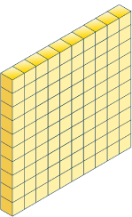
Starter
Which is the odd one out?
200 + 60 + 3
260
270
The number line is the odd one out. It shows 264, not 263.
Answers
Notes:
Concrete resources – Base 10, counters, number line
Key Questions – Which numbers are being represented? How do you know? Why are some of them similar? How do you know which one is the odd one out?
Extension – Create another set of representations showing the same number as the odd one out.

Slide 7
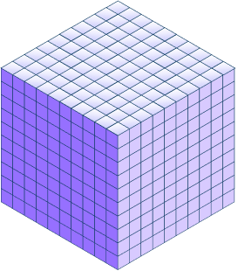
Let’s Learn
Complete the sentence stems for the representation.
There are 7 thousands, 2 hundreds, 4 tens and 9 ones.
The number is 7,249.
7,000 + 200 + 40 + 9 = 7,249
There are _____ thousands, _____ hundreds, _____ tens and _____ ones.
The number is _____.
_____ + _____ + _____ + _____ = _____
Answers
Notes:
Concrete resources – Base 10
Key Questions – How many thousands/ hundreds/ tens/ ones are there? How do I write 7 thousands in numerals? Why have I written an addition calculation below? What does that mean? How is addition linked to partitioning?
Misconceptions/ Common Errors – Pupils may identify 7 thousands (for example) and write this as 7 in the addition calculation.
Extension – “There are 2 hundreds, 7 thousands, 9 ones and 4 tens. The number is 2,794.” Explain the mistake.

Slide 8
Follow Me
Complete the sentence stems for the representations.
There are 4 thousands, 3 hundreds, 1 ten and 1 one.
The number is 4,311.
4,000 + 300 + 1 + 1 = 4,311
There is 1 thousand, 4 hundreds and 3 tens.
The number is 1,430.
1,000 + 400 + 30 = 1,430
There are _____ thousands, _____ hundreds, _____ tens and _____ ones.
The number is _____.
_____ + _____ + _____ + _____ = _____
Answers
Notes:
Concrete resources – Base 10, counters
Key Questions – Which number is being represented? What is this in numerals? How do you know?
Misconceptions/ Common Errors – Pupils may write the addition question as 1,000 + 1,000 + 1,000 + 1,000 + 100 + 100 etc.
Extension – A partitioned number is 5,000 + 300 + 20 + 0. Represent this number using counters and base 10. Complete the sentence stems for this number.

Slide 9
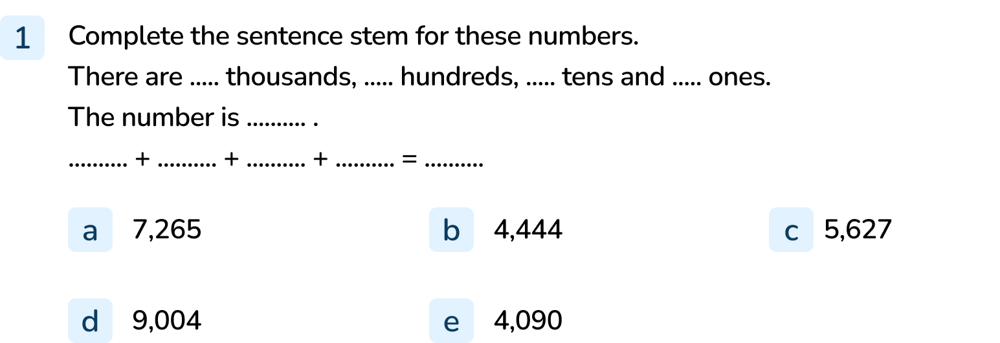
Your Turn
Notes:
There are 7 thousands, 2 hundreds, 6 tens and 5 ones. The number is 7,265. 7,000 + 200 + 60 + 5 = 7,265
There are 4 thousands, 4 hundreds, 4 tens and 4 ones. The number is 4,444. 4,000 + 400 + 40 + 4 = 4,444
There are 5 thousands, 6 hundreds, 2 tens and 7 ones. The number is 5,627. 5,000 + 600 + 20 + 7 = 5,627
There are 9 thousands, 0 hundreds, 0 tens and 4 ones. The number is 9,004. 9,000 + 4 = 9,004
There are 4 thousands, 0 hundreds, 9 tens and 0 ones. The number is 4,090. 4,000 + 90 = 4,090

Slide 10
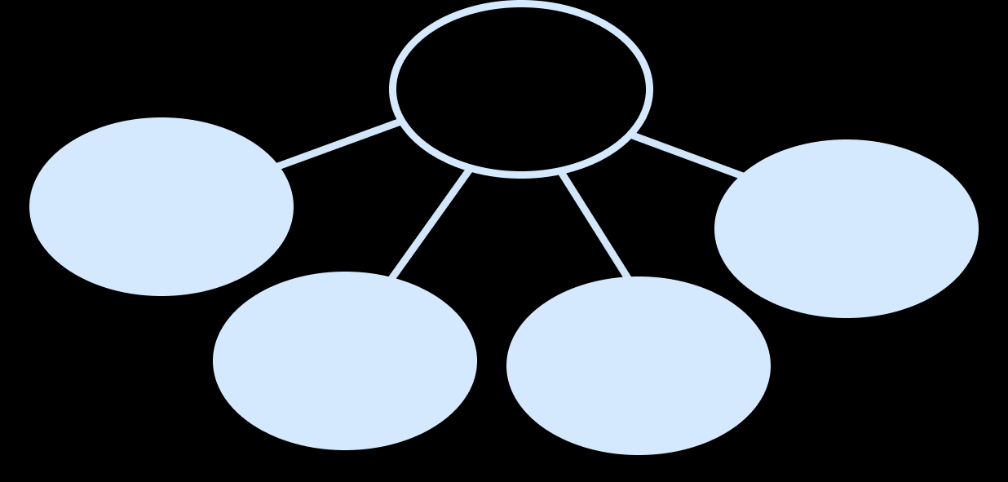
Follow Me
The Mathling thinks they have shown the number using a part-whole model.
Are they right?
5,452
5,000
2
400
50
Notes:
The Mathling is right, explanations will vary.
Concrete resources – Counters
Key Questions – Is the number in the ‘whole’ of the part-whole model the same as the counters? How do you know? How is a part-whole model similar to the partition calculation from the sentence stem?
Further Practice – Partition other numbers using a part-whole model
Extension – Would these numbers in the part-whole number, still represent 5,452? Whole - 5,453. Parts - 5,000, 400, 52

Slide 11
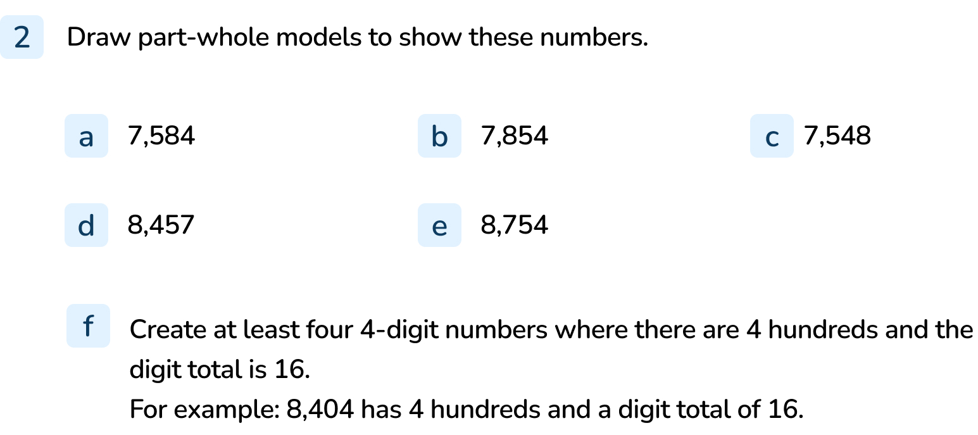
Your Turn
Notes:
a to e) The questions should show accurate examples of part-whole models that reflect the numbers given.
f) There are multiple solutions. The pupil must ensure that their answers meet the criteria. Example answers: 4,444, 1,492, 4,408, 2,455
To extend question f, tell pupils they cannot repeat digits, e.g. 8,404 is not allowed as 4 is repeated. 1,492 is acceptable as there are no repeated digits.

Slide 12
Follow Me
How many different ways can you represent 3,207?
3,200
3,210
Answers
Notes:
These are some examples.
Concrete resources – Base 10, counters, number line, place value grid
Key Questions – Did you find any different ways? Do all your answers represent the given number?
Extension – Make a mistake in one of your representations. Explain your mistake. (If possible, swap representations with a peer, can they spot the mistake?)

Slide 13
Your Turn
Notes:
Accept answers where representations are accurate. Pupils may identify that the digits are all the same but the value changes depending on where they are placed in the number.

Slide 14
Let’s Reflect
Write two examples and two non-example of 4-digit numbers where the tens column contains the digit 6.
Example: 5,461
Non-example: 5,441
Notes:
Example and non-example question help pupils to define numbers (in this case) that meet a criteria but also understand which numbers do not fit the criteria and why.
Concrete resources – Counters, base 10, place value charts, number lines (anything the pupils have used in the lesson and would find useful).
Key Questions – What is an ‘example’ and ‘non-example’? Explain your reasoning. How do you know? Prove your answer is correct.

Slide 15
The following slides are based on: 100s, 10s and 1s

Slide 16
What is the value of the numbers represented?
603
265
136
Answers
Notes:
How and when to use these slides – If pupils struggle to understand how to represent numbers including 1,000s use these slides with them to secure their understanding of representing numbers using 100s, 10s and 1s only.
Concrete resources – Base 10, counters
Key Questions – How do you read a place value chart? How many base 10/ counters are in the x column? Why are there no counters in the tens column?
Misconceptions/ Common Errors – Not understanding how to write that there are no counters in the tens column (place value chart containing counters). Some pupils may find one type of representation easier to read than another (e.g. counters are easier to read than base 10).

Slide 17
Make the number 548 in as many different ways as possible.
Notes:
How and when to use these slides – If pupils struggle to understand how to represent numbers including 1,000s use these slides with them to secure their understanding of representing numbers using 100s, 10s and 1s only.
Concrete resources – Range of concrete resources (base 10, counters, number line, place value chart etc)
Key Questions – How many hundreds/ tens/ ones are there? How could you use (counters etc) to show this?
Misconceptions/ Common Errors – Pupils may try to represent different numbers each time, not the same number.

